Slide 1
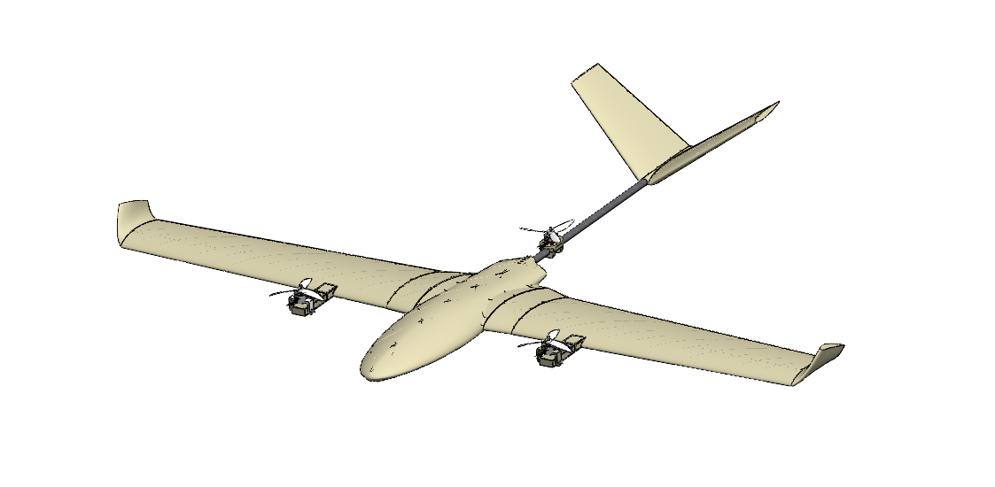
Vertical Take-off Landing (VTOL) Aircraft
Metin Öz Harun Üner Ömer Karataş
2019405000 2019405207 2019405033

Slide 2
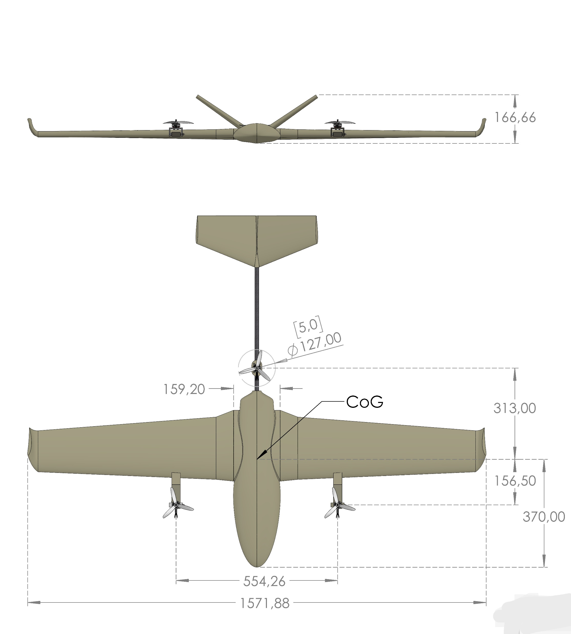

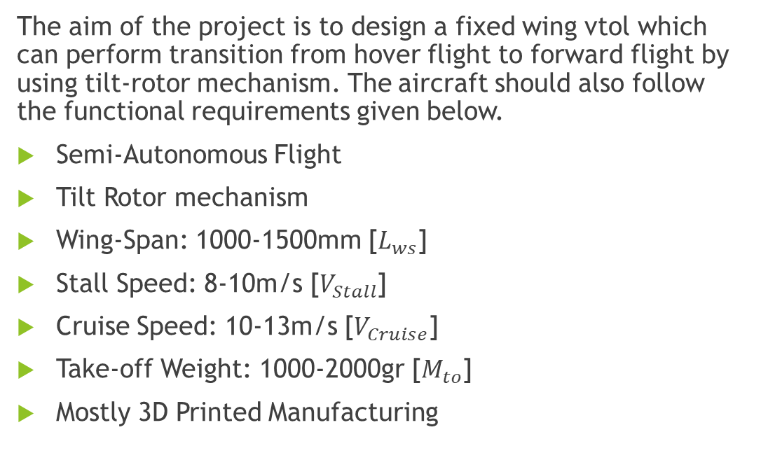
Problem Definition and Functional Requirements :
The aim of the project is to design a fixed wing vtol which can perform transition from hover flight to forward flight by using tilt-rotor mechanism. The aircraft should also follow the functional requirements given below.
Semi-Autonomous Flight
Tilt Rotor mechanism
Wing-Span: 1000-1500mm [$L_{ws}$]
Stall Speed: 8-10m/s [$V_{Stall}$]
Cruise Speed: 10-13m/s [$V_{Cruise}$]
Take-off Weight: 1000-2000gr [$M_{to}$]
Mostly 3D Printed Manufacturing

Slide 3
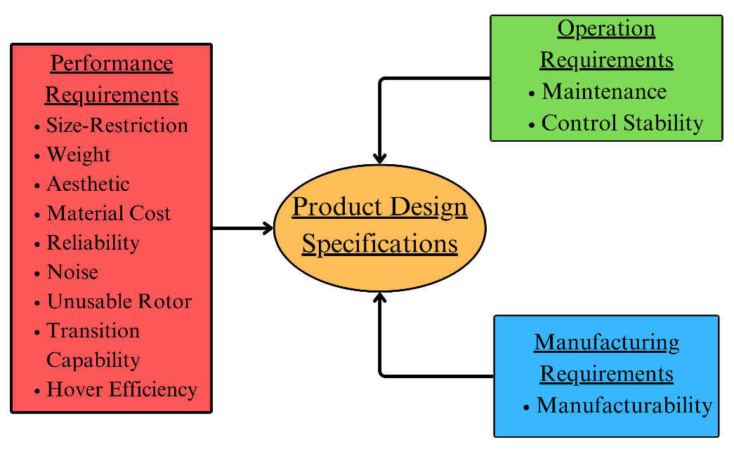
Product Design Specifications
Control Stability
Unusable Rotors
Transition Capabilities
Hover Efficiency

Slide 4
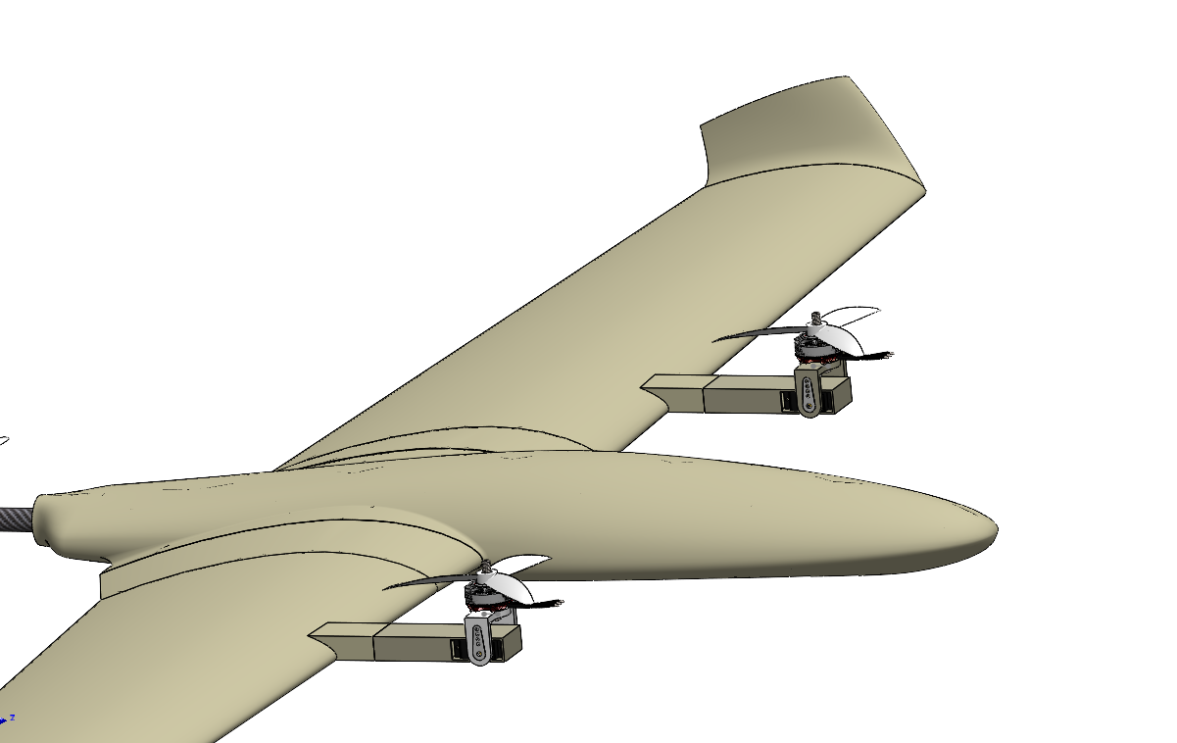
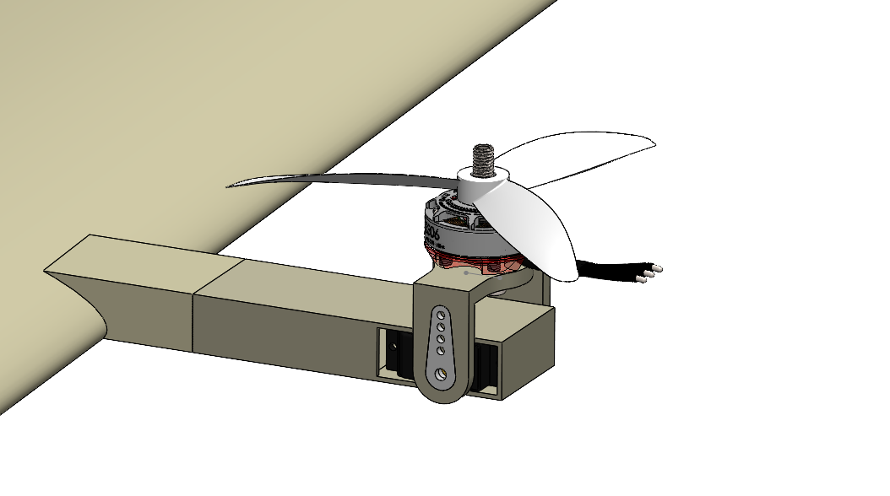
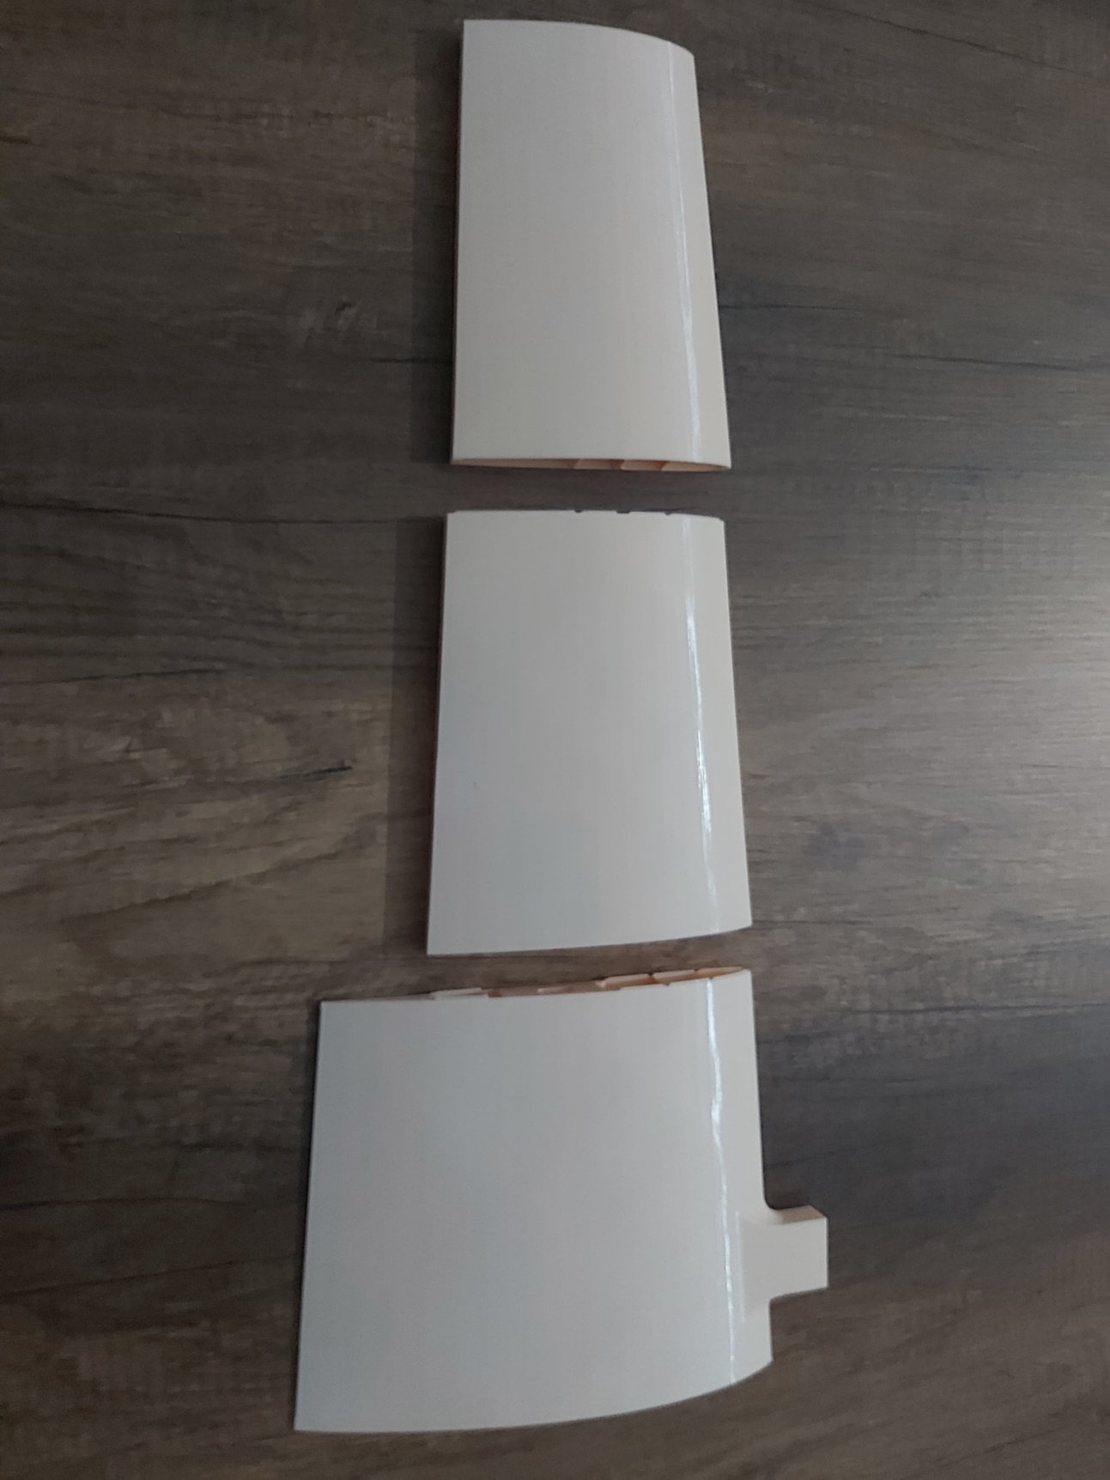
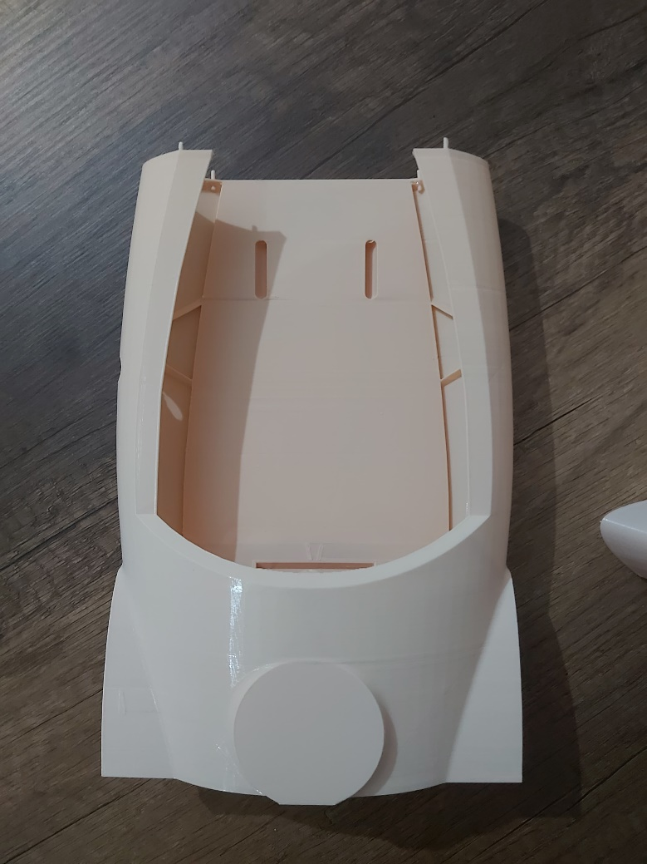
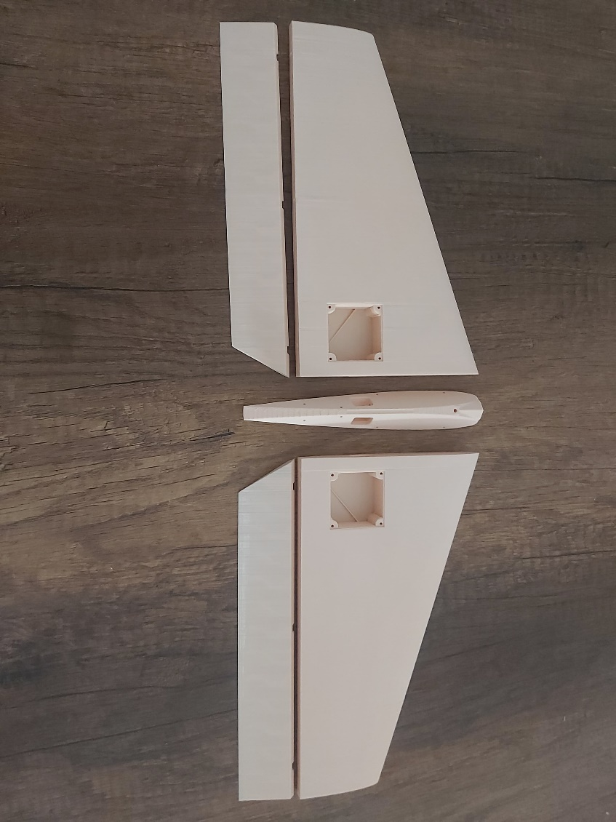
Tilting Mechanism:
Brushless Servo Motor
Motor
Mostly 3D Printed Manufacturing:
Fuselage
Wing
V-Tail

Slide 5
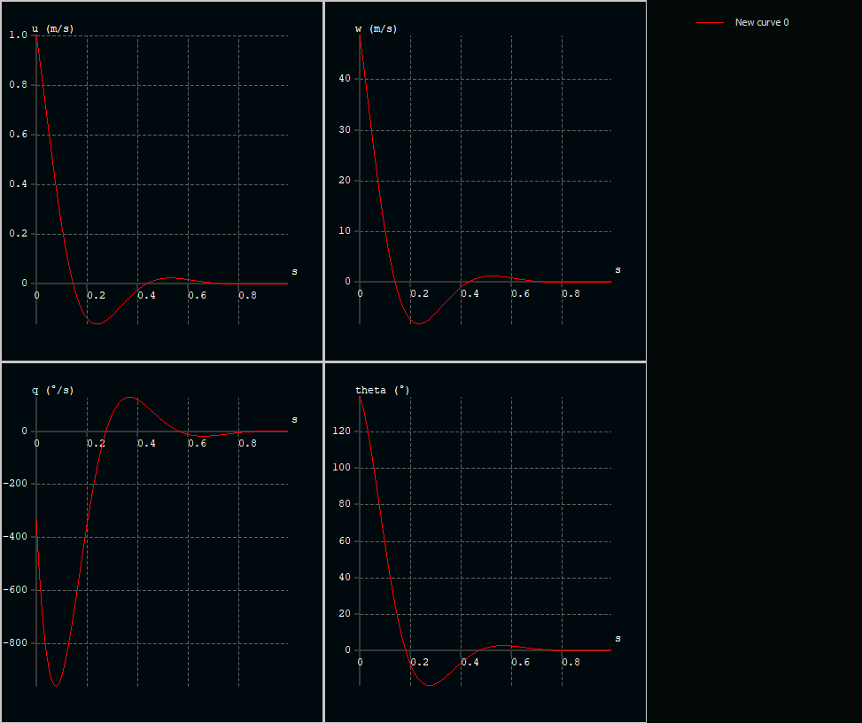
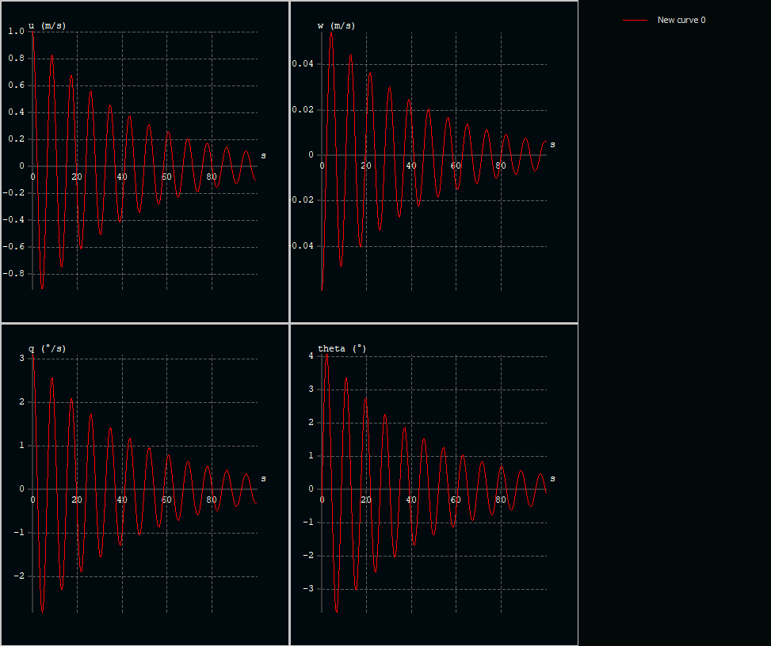
XFLR 5 Analysis of the Produced Prototype
Longitudinal Modes
Short Period Longitudinal
Phugoid

Slide 6
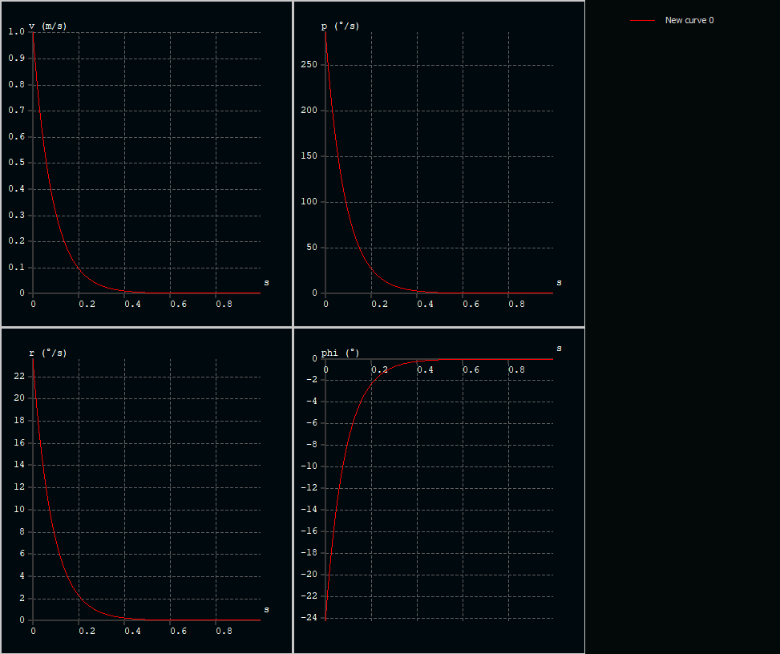
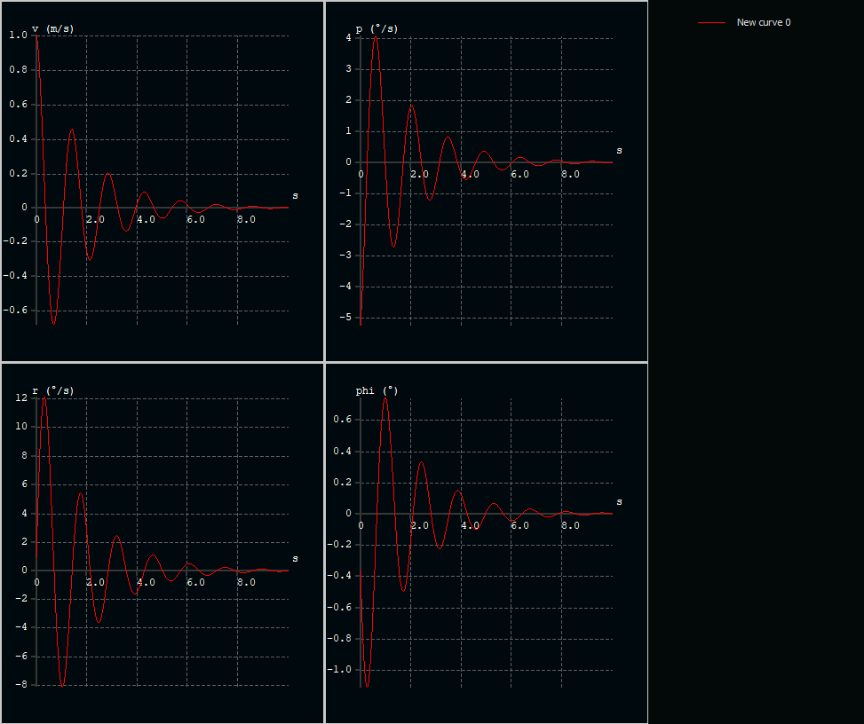
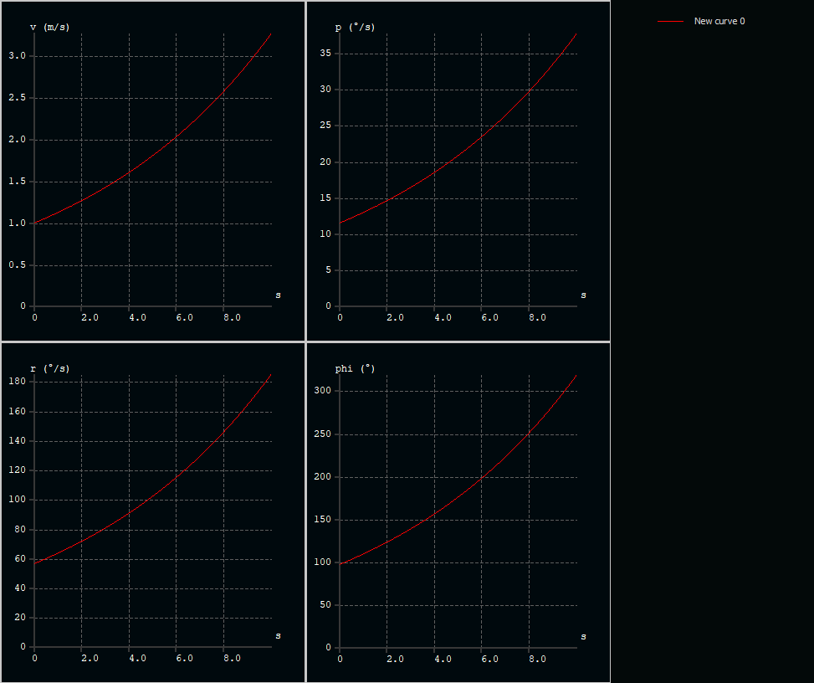
XFLR 5 Analysis of the Produced Prototype
Lateral Modes
Roll Damping
Dutch Roll
Spiral

Slide 7

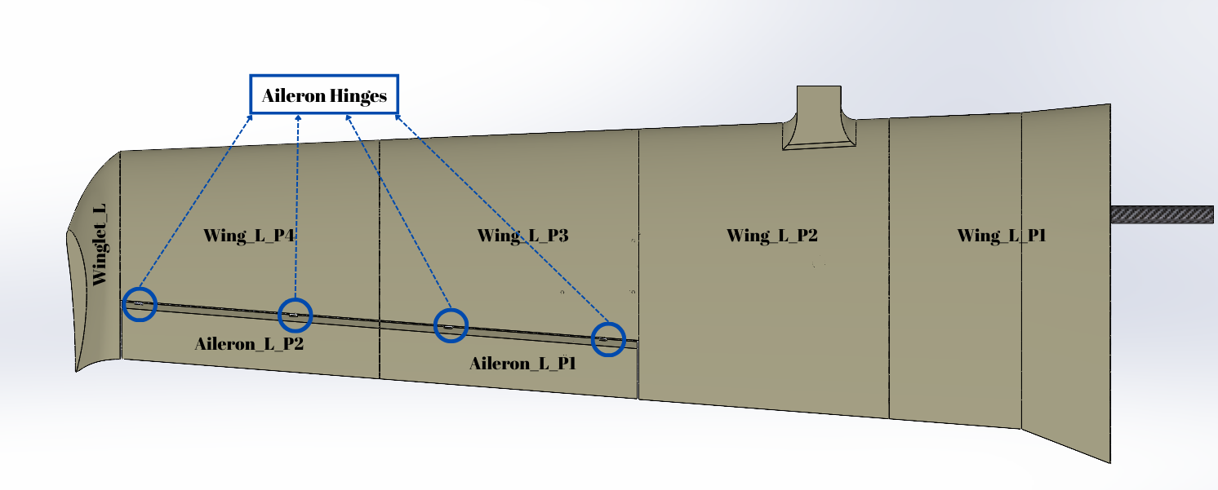
Parts of the Wing Section
There are 7 sections to be 3D Printed for each wing
They were cutted from the final design
Necessary updates have been made at the merge zones

Slide 8
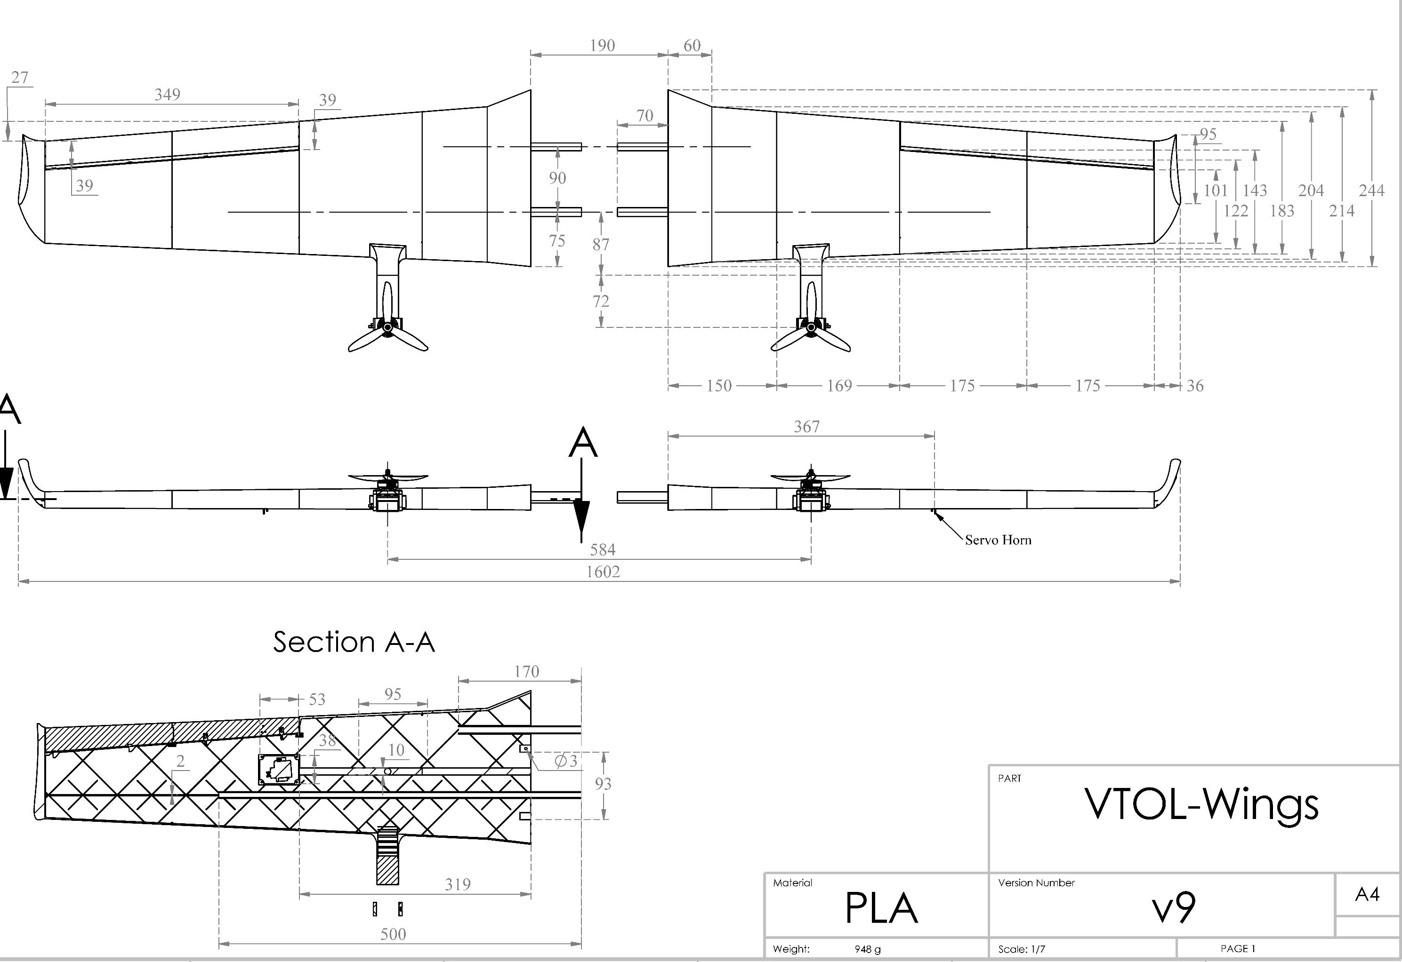

Slide 9
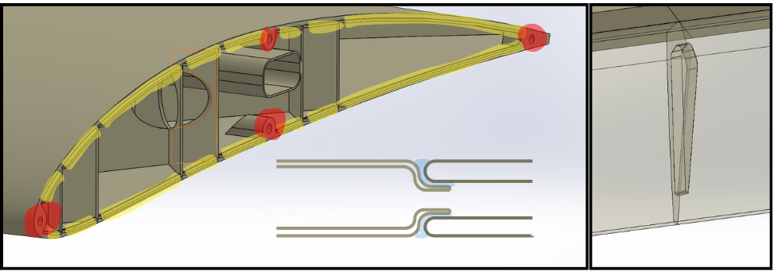
Aileron Connection Lugs
Snap-Joint connection tabs are indicated as yellow.
-Creates larger surface areas for adhesives
-Prevents collapse of walls at connectios
Pin holes are indicated as red.
-They are designed to fit 1.75mm filament pins
-Simplifies alignment and creates strong attachment points

Slide 10
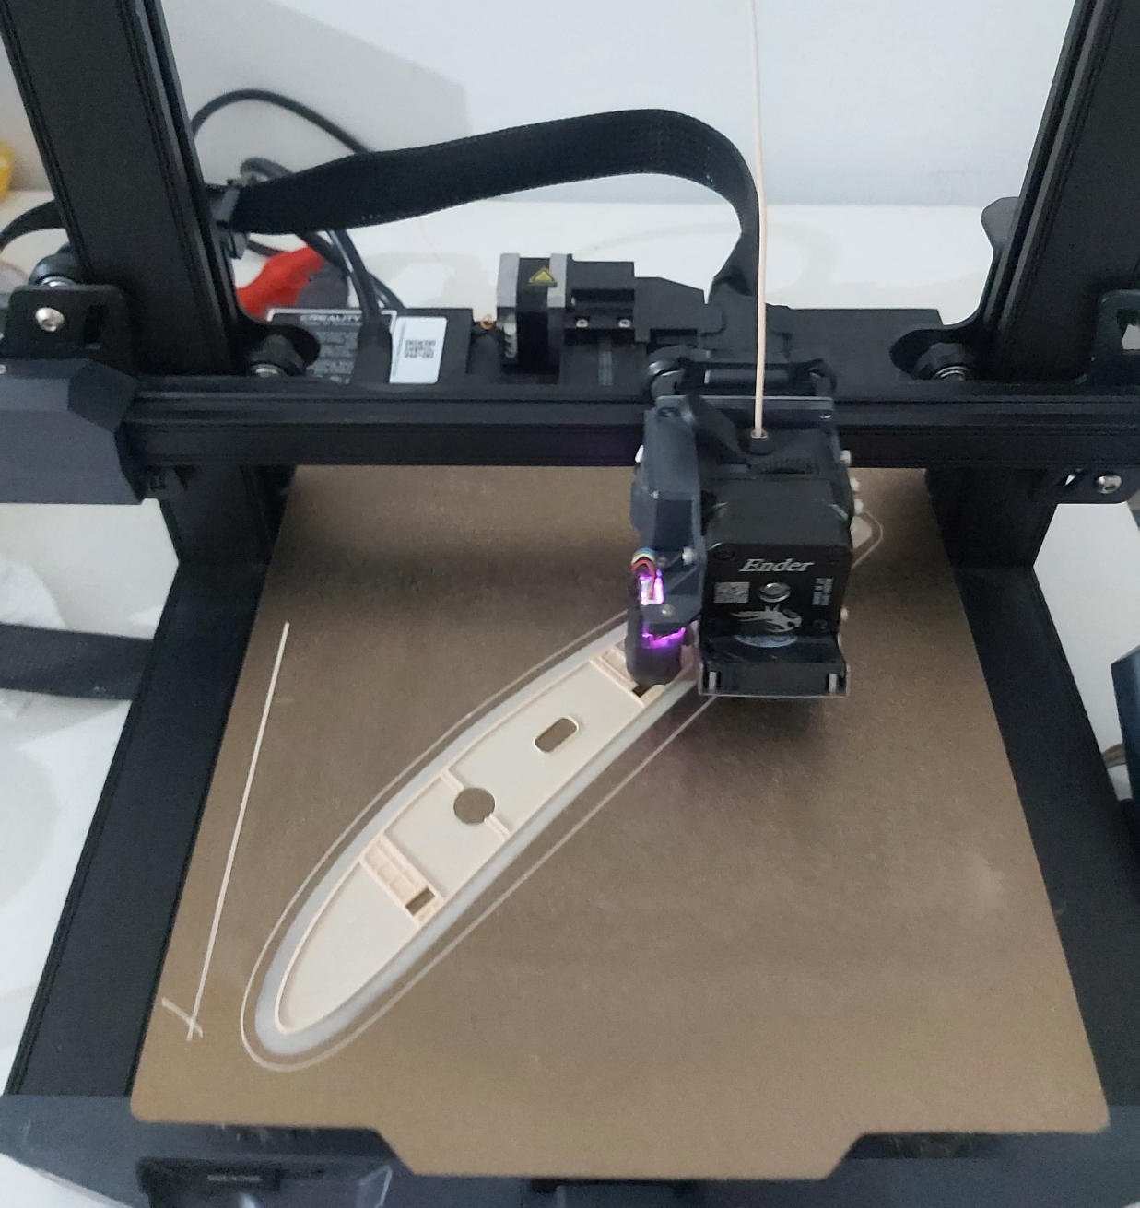
Printing Times of the parts
Wing_L_P1 | 12h 50min
Wing_L_P2 | 12h 12min
Wing_L_P3 | 9h 26min
Wing_L_P4 | 7h 47min
Winglet_L | 2h 15min
Aileron_L_P1 | 3h 16min
Aileron_L_P2 | 3h 20min
Total (x2) | 102h 12min
It takes 7 days to print all wing parts. Ailerons and part 4 is printed several times due to printing problems.

Slide 11

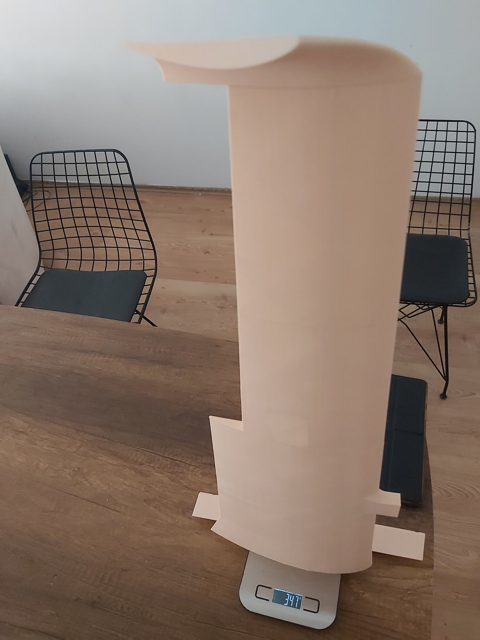
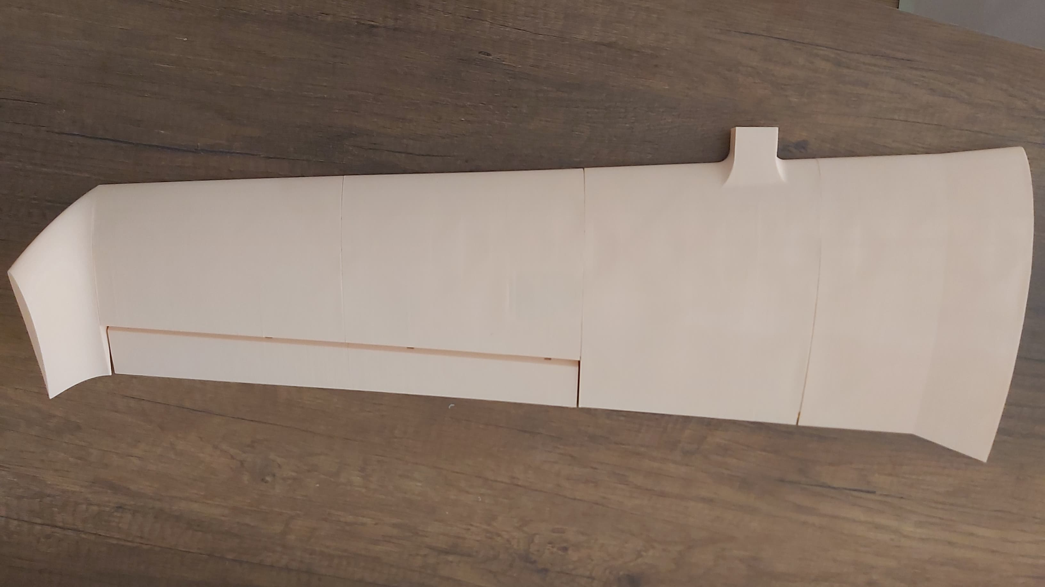
One side of the printed wing weighs only 347g
Not glued only snap joint holds them together

Slide 12
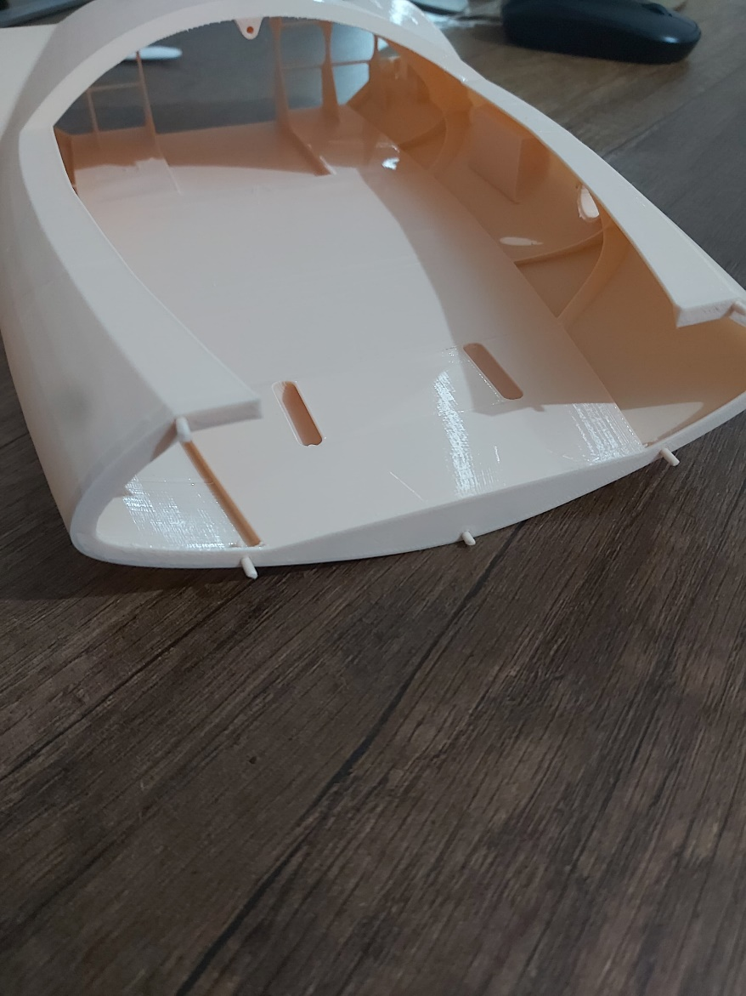
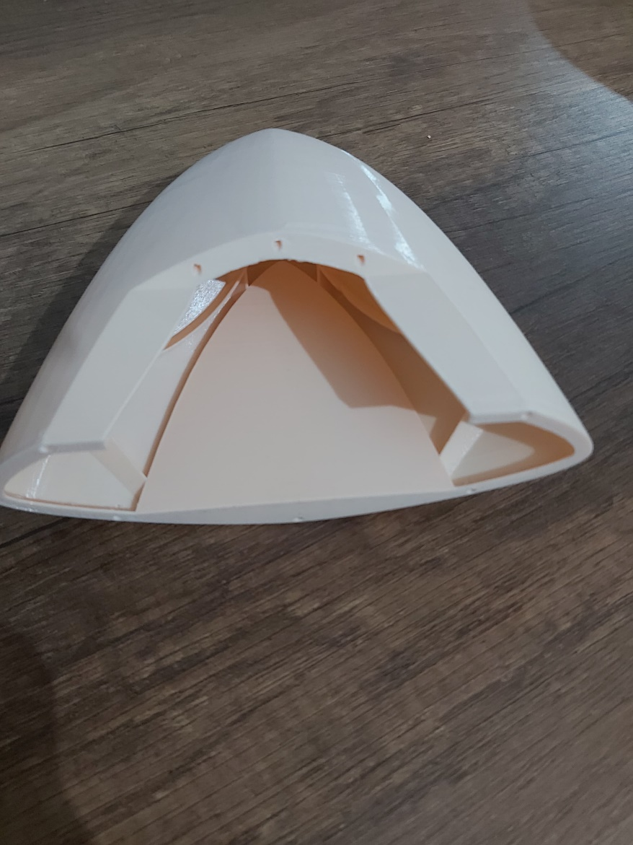

Manufacturing of Fuselage
Fuselage_P1 | 16h 5min
Fuselage_P2 | 15h 40min
Fuselage_P3 | 6h 10min
Front_Cap | 4h 20min
Rear_Cap | 3h 8min
Total (x2) | 45h 23min
It takes 3 days to print all Fuselage parts. There was no problem encountered.

Slide 13
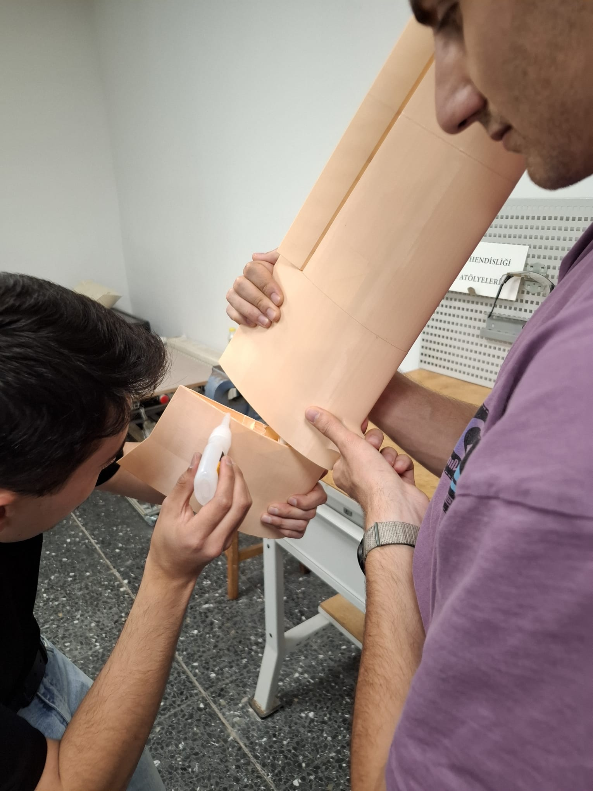
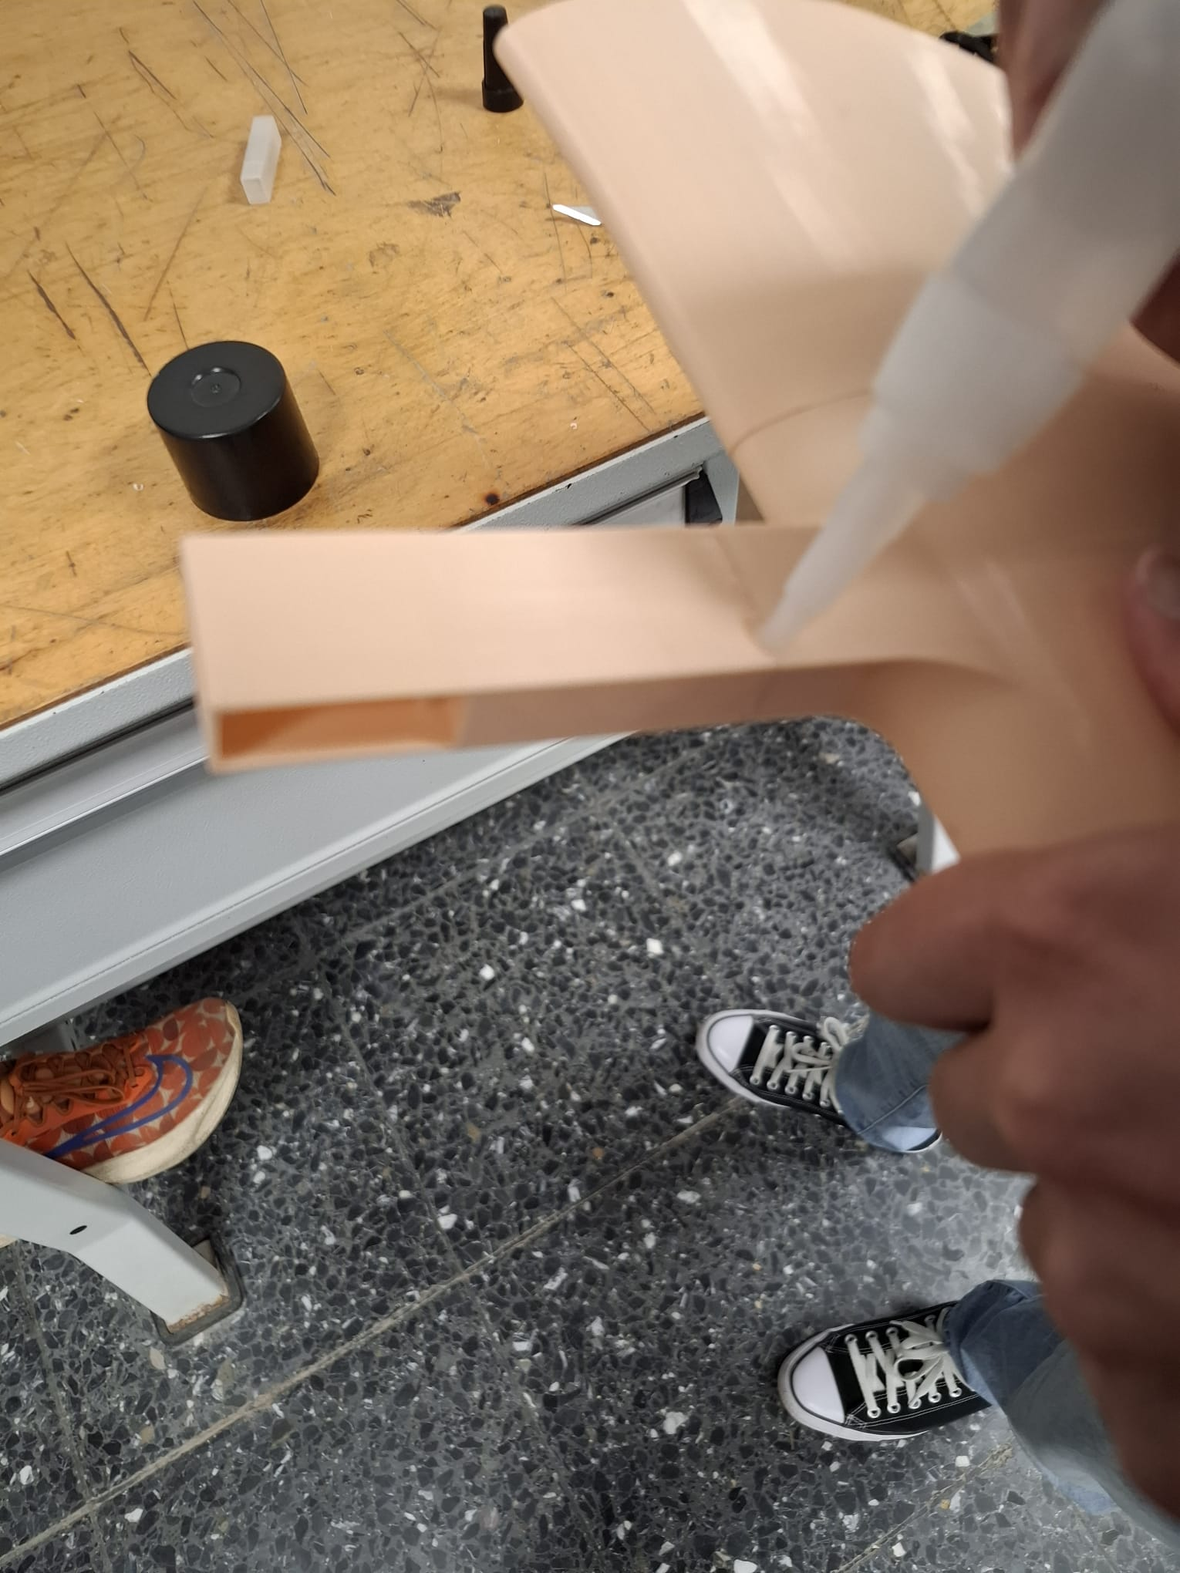
Assembly of Wing
Gluing wing parts
Gluing wing arm
Parts are aligned using pins.
Attached together using glue.

Slide 14
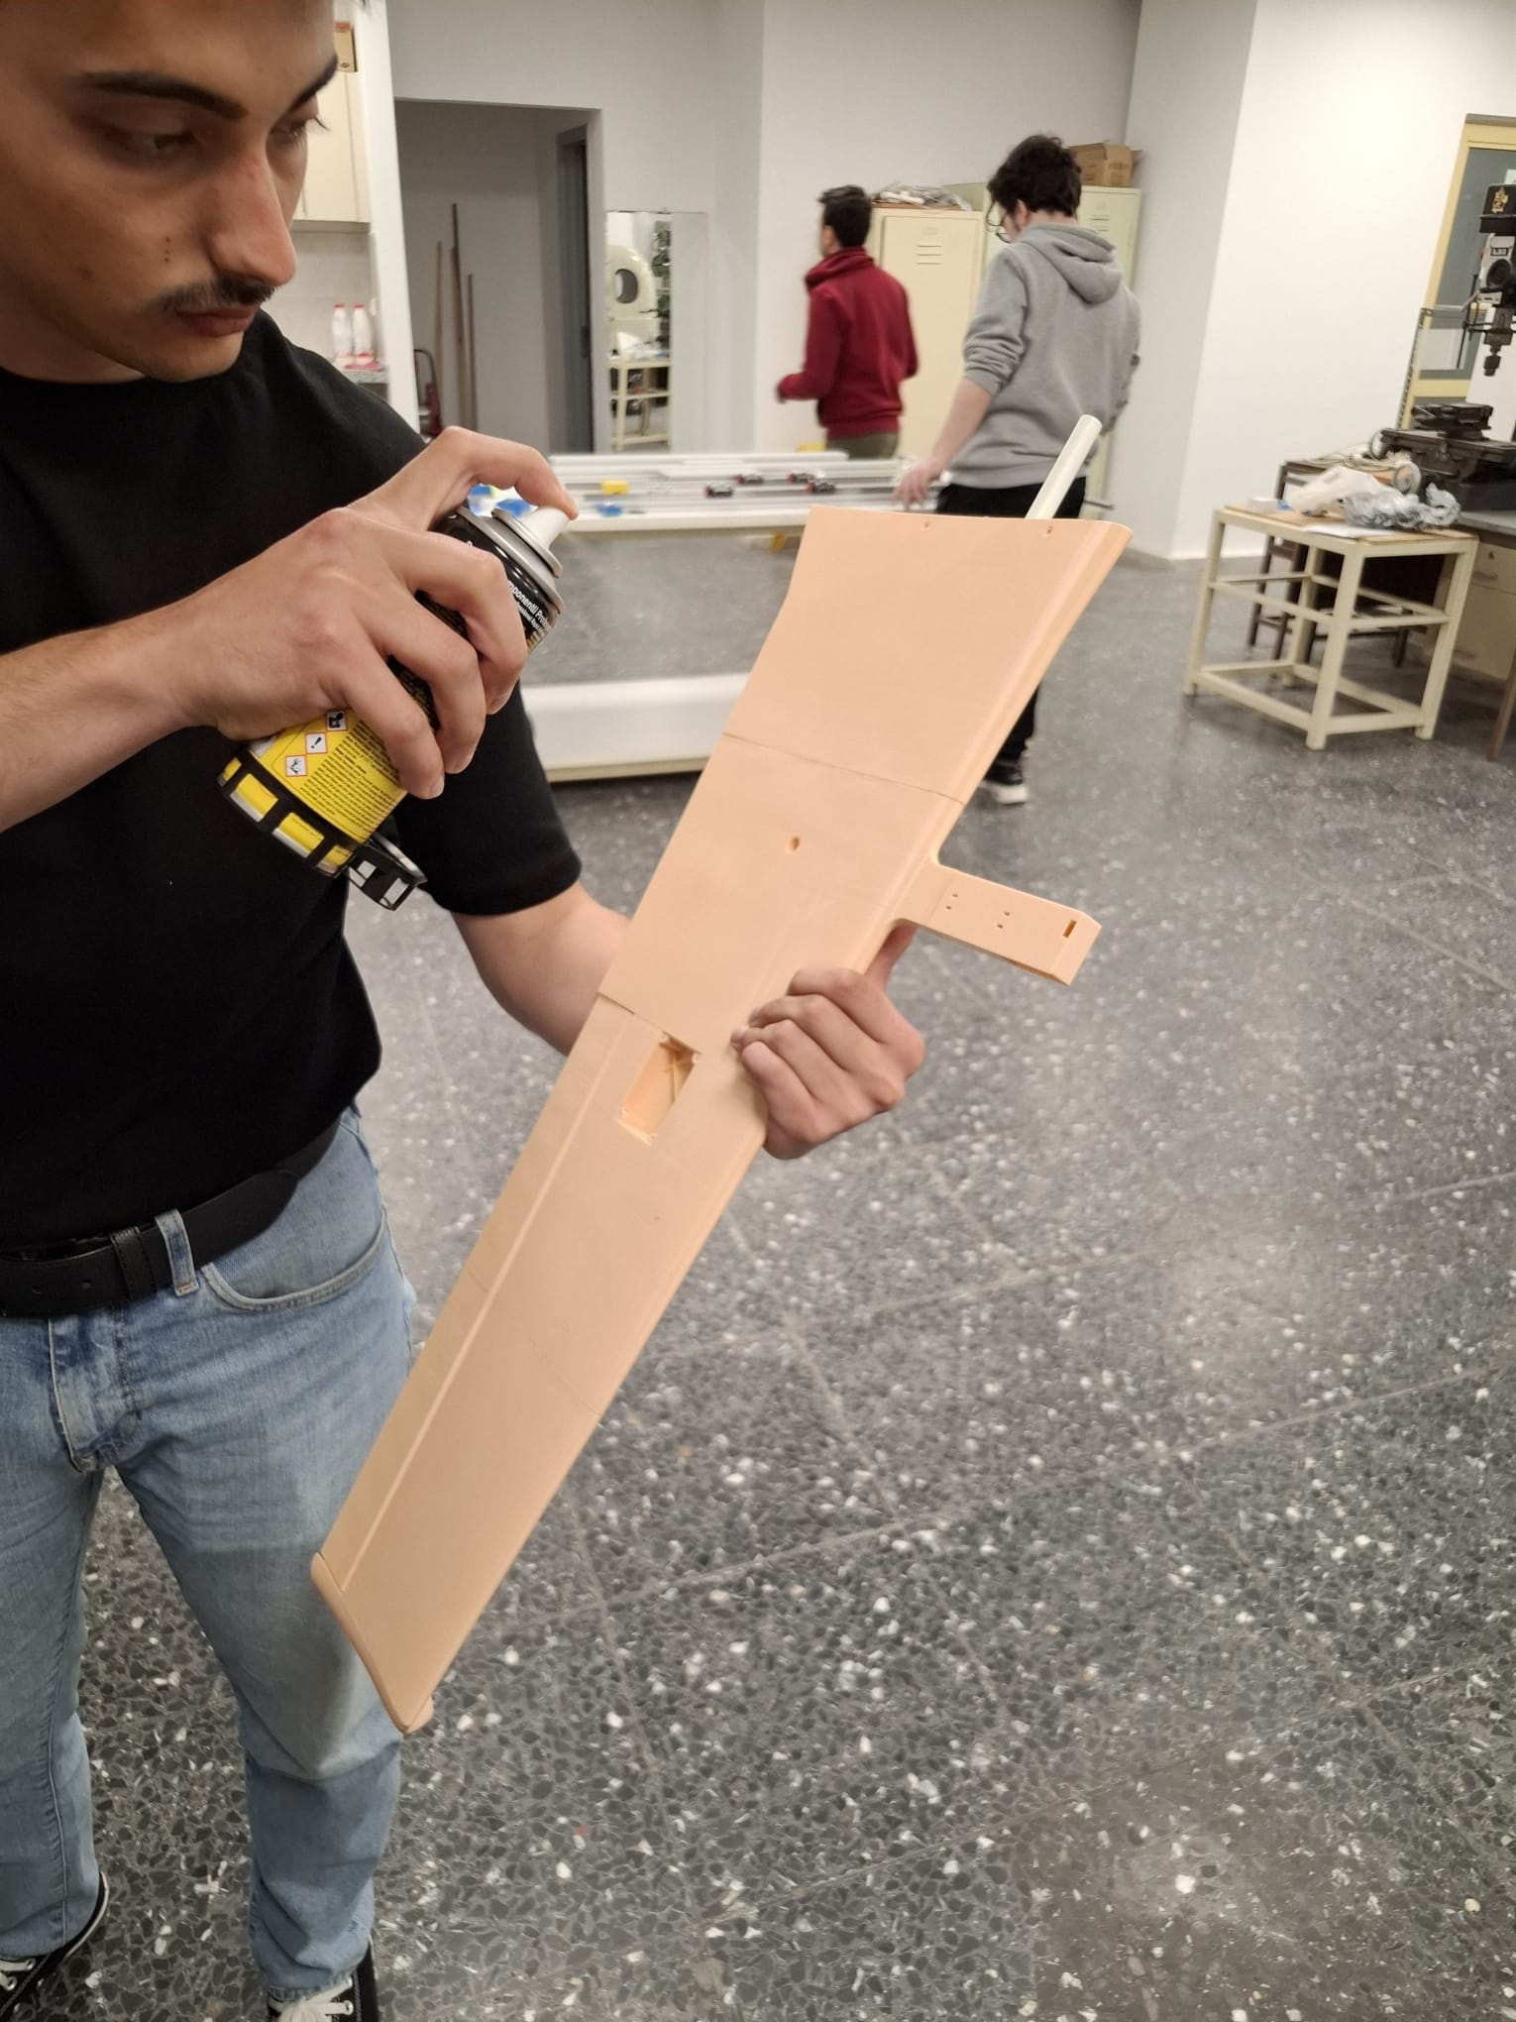
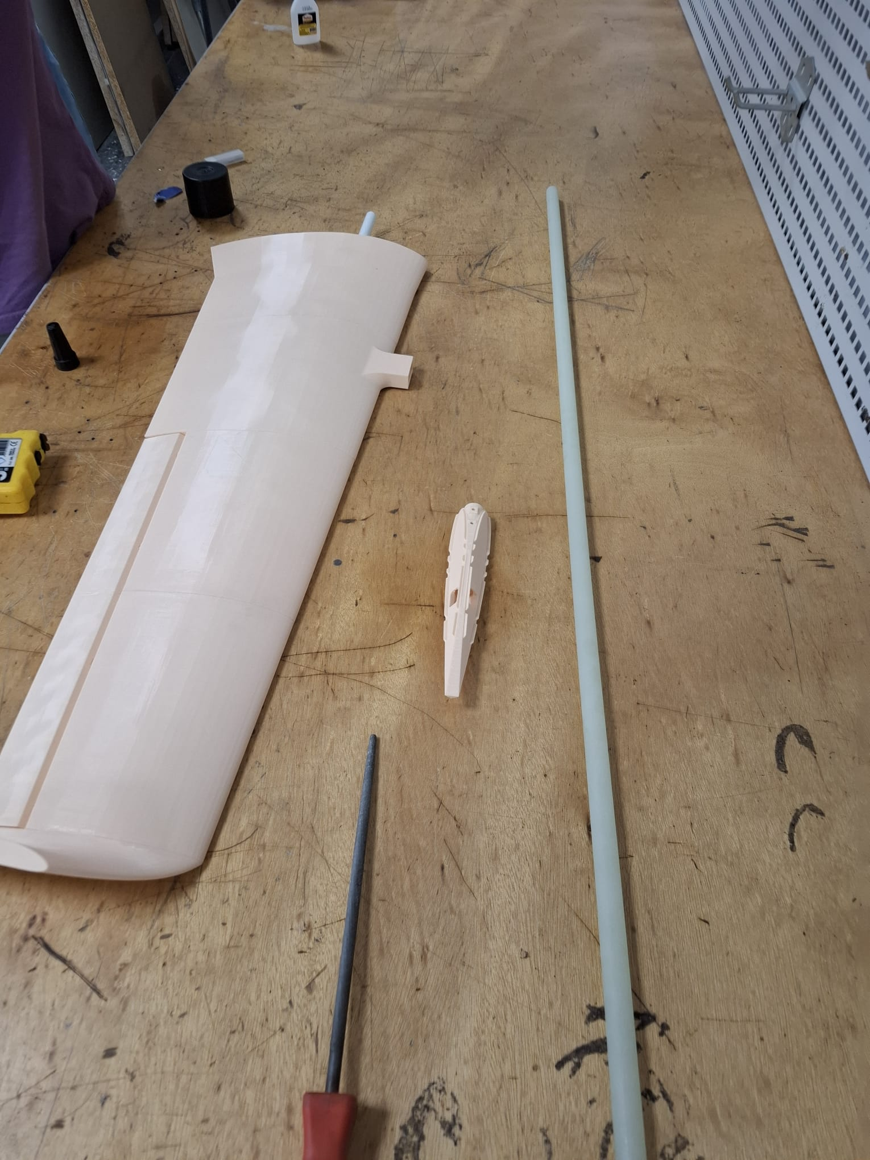
Assembly of Wing
Two part glue activator
Assembled wing
Two part glue is used for attaching parts.
Glass fiber pipe is added.

Slide 15
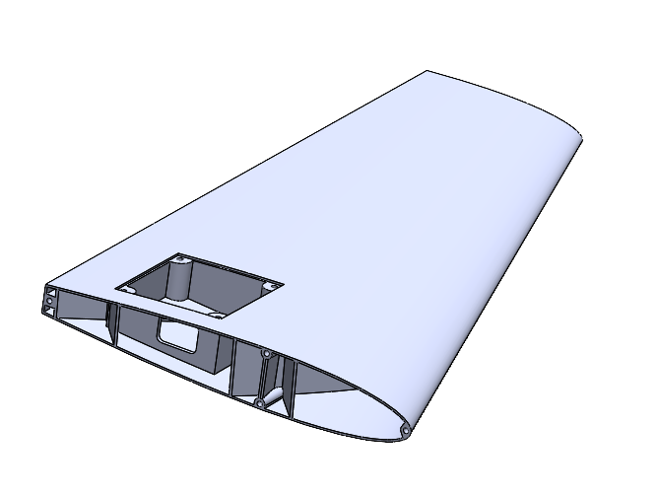
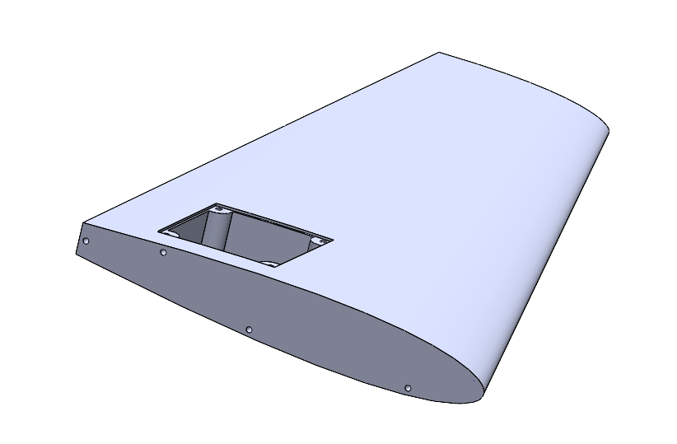
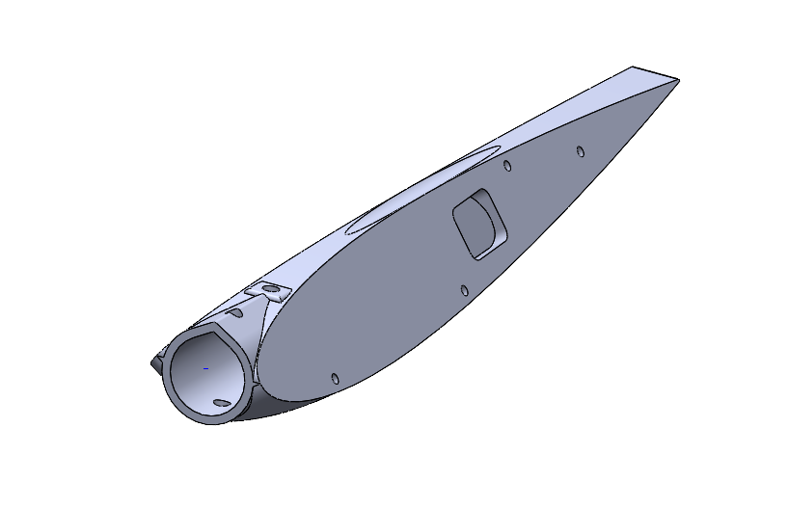
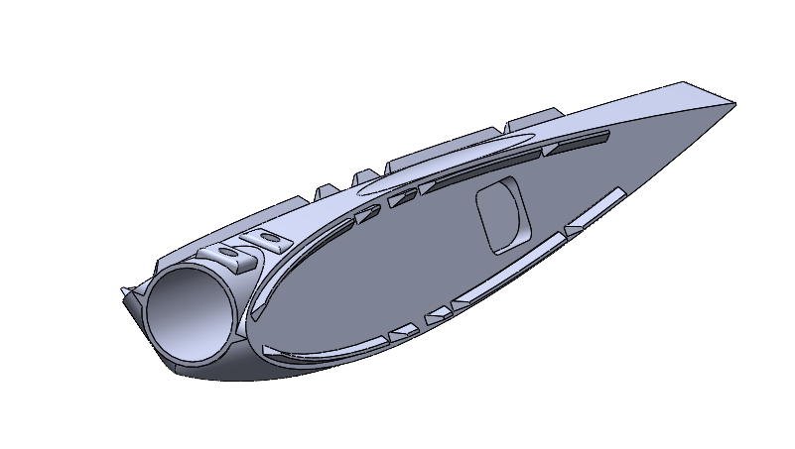
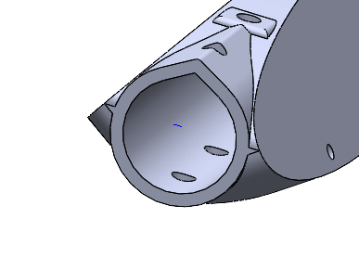
Changes in the design of V-Tail
Better adhesion
Better durability
Ease of printing

Slide 16
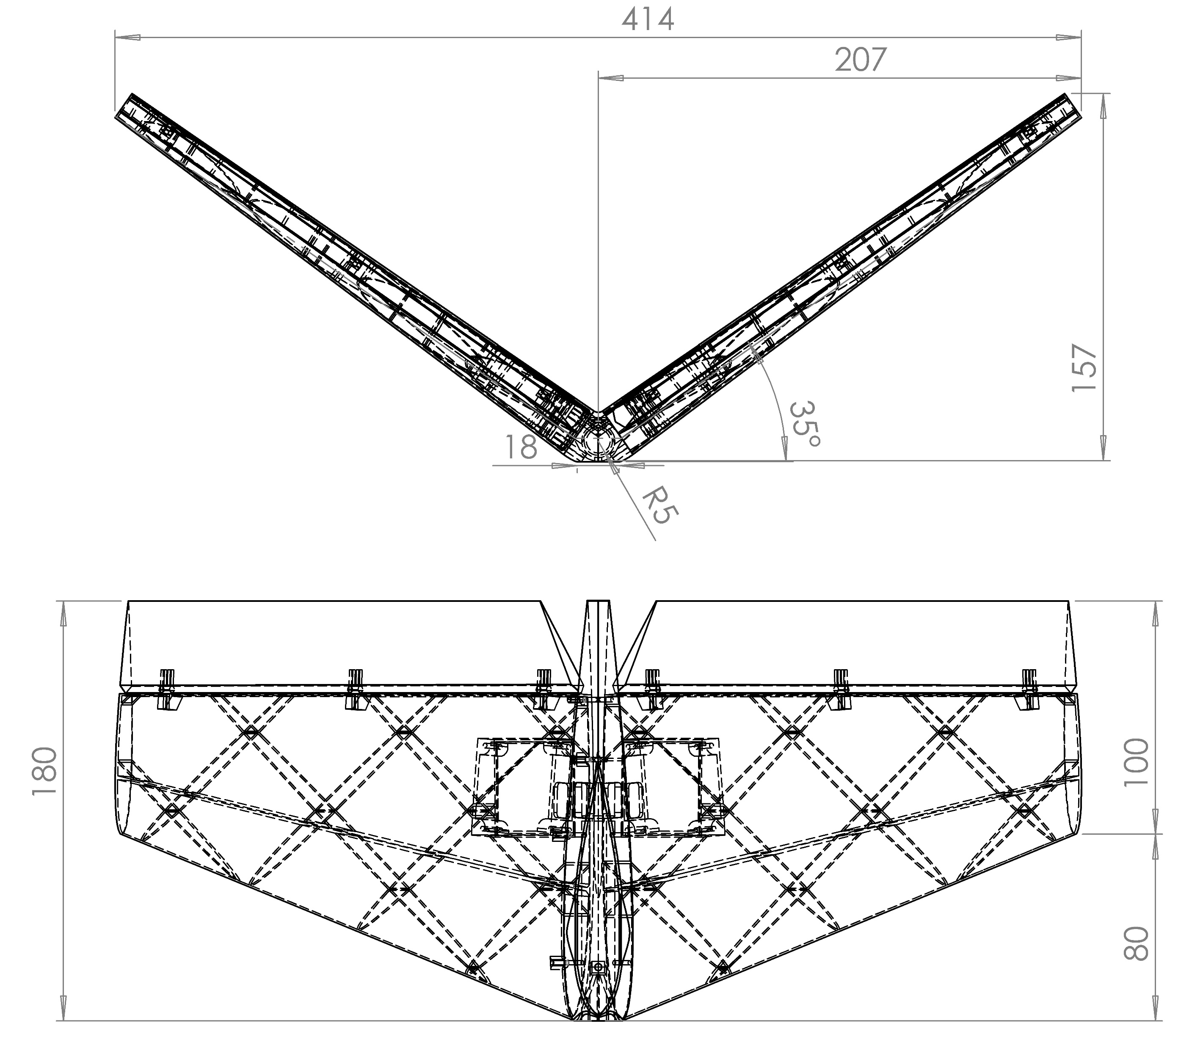

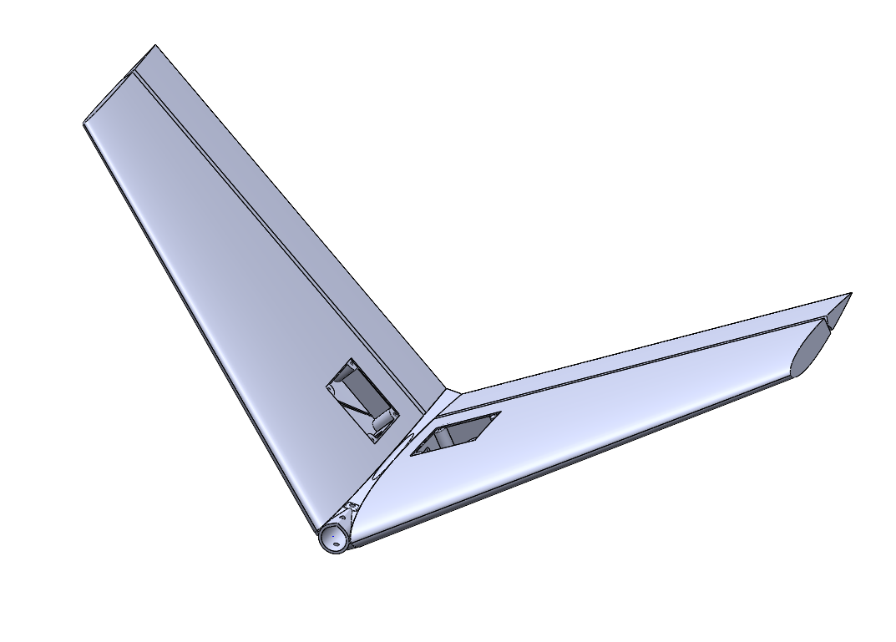
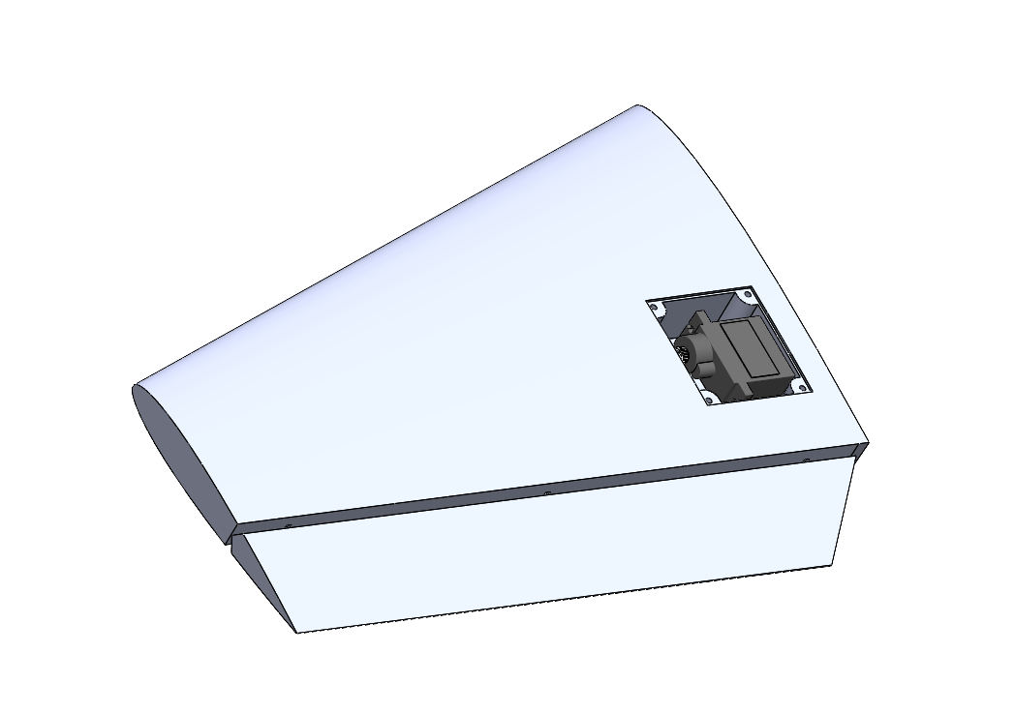
Assembly of V-Tail

Slide 17
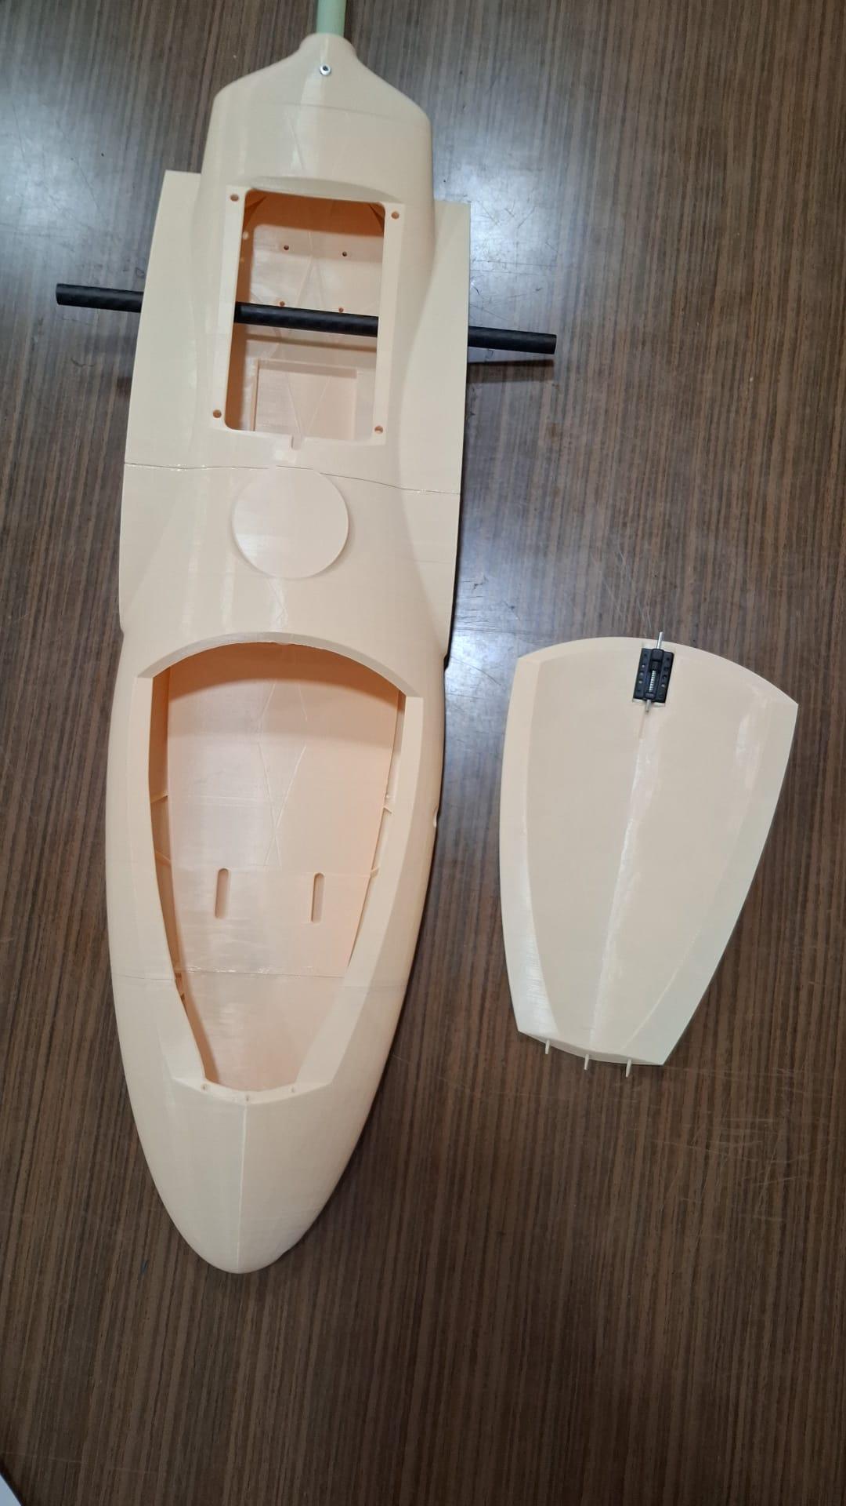
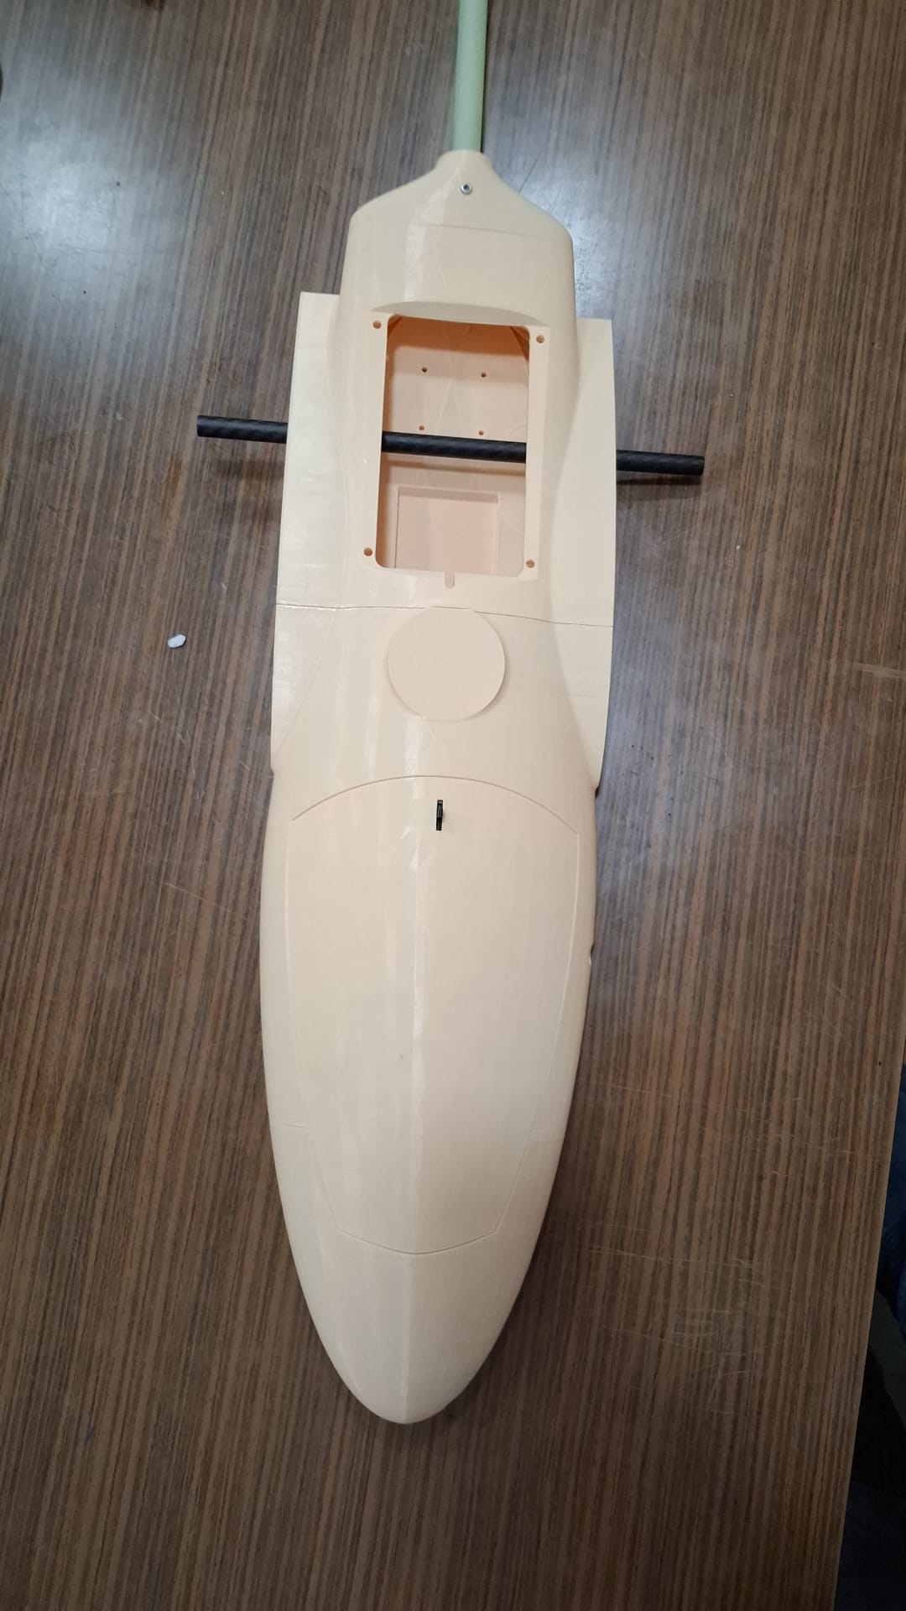
Assembly of Fuselage

Slide 18
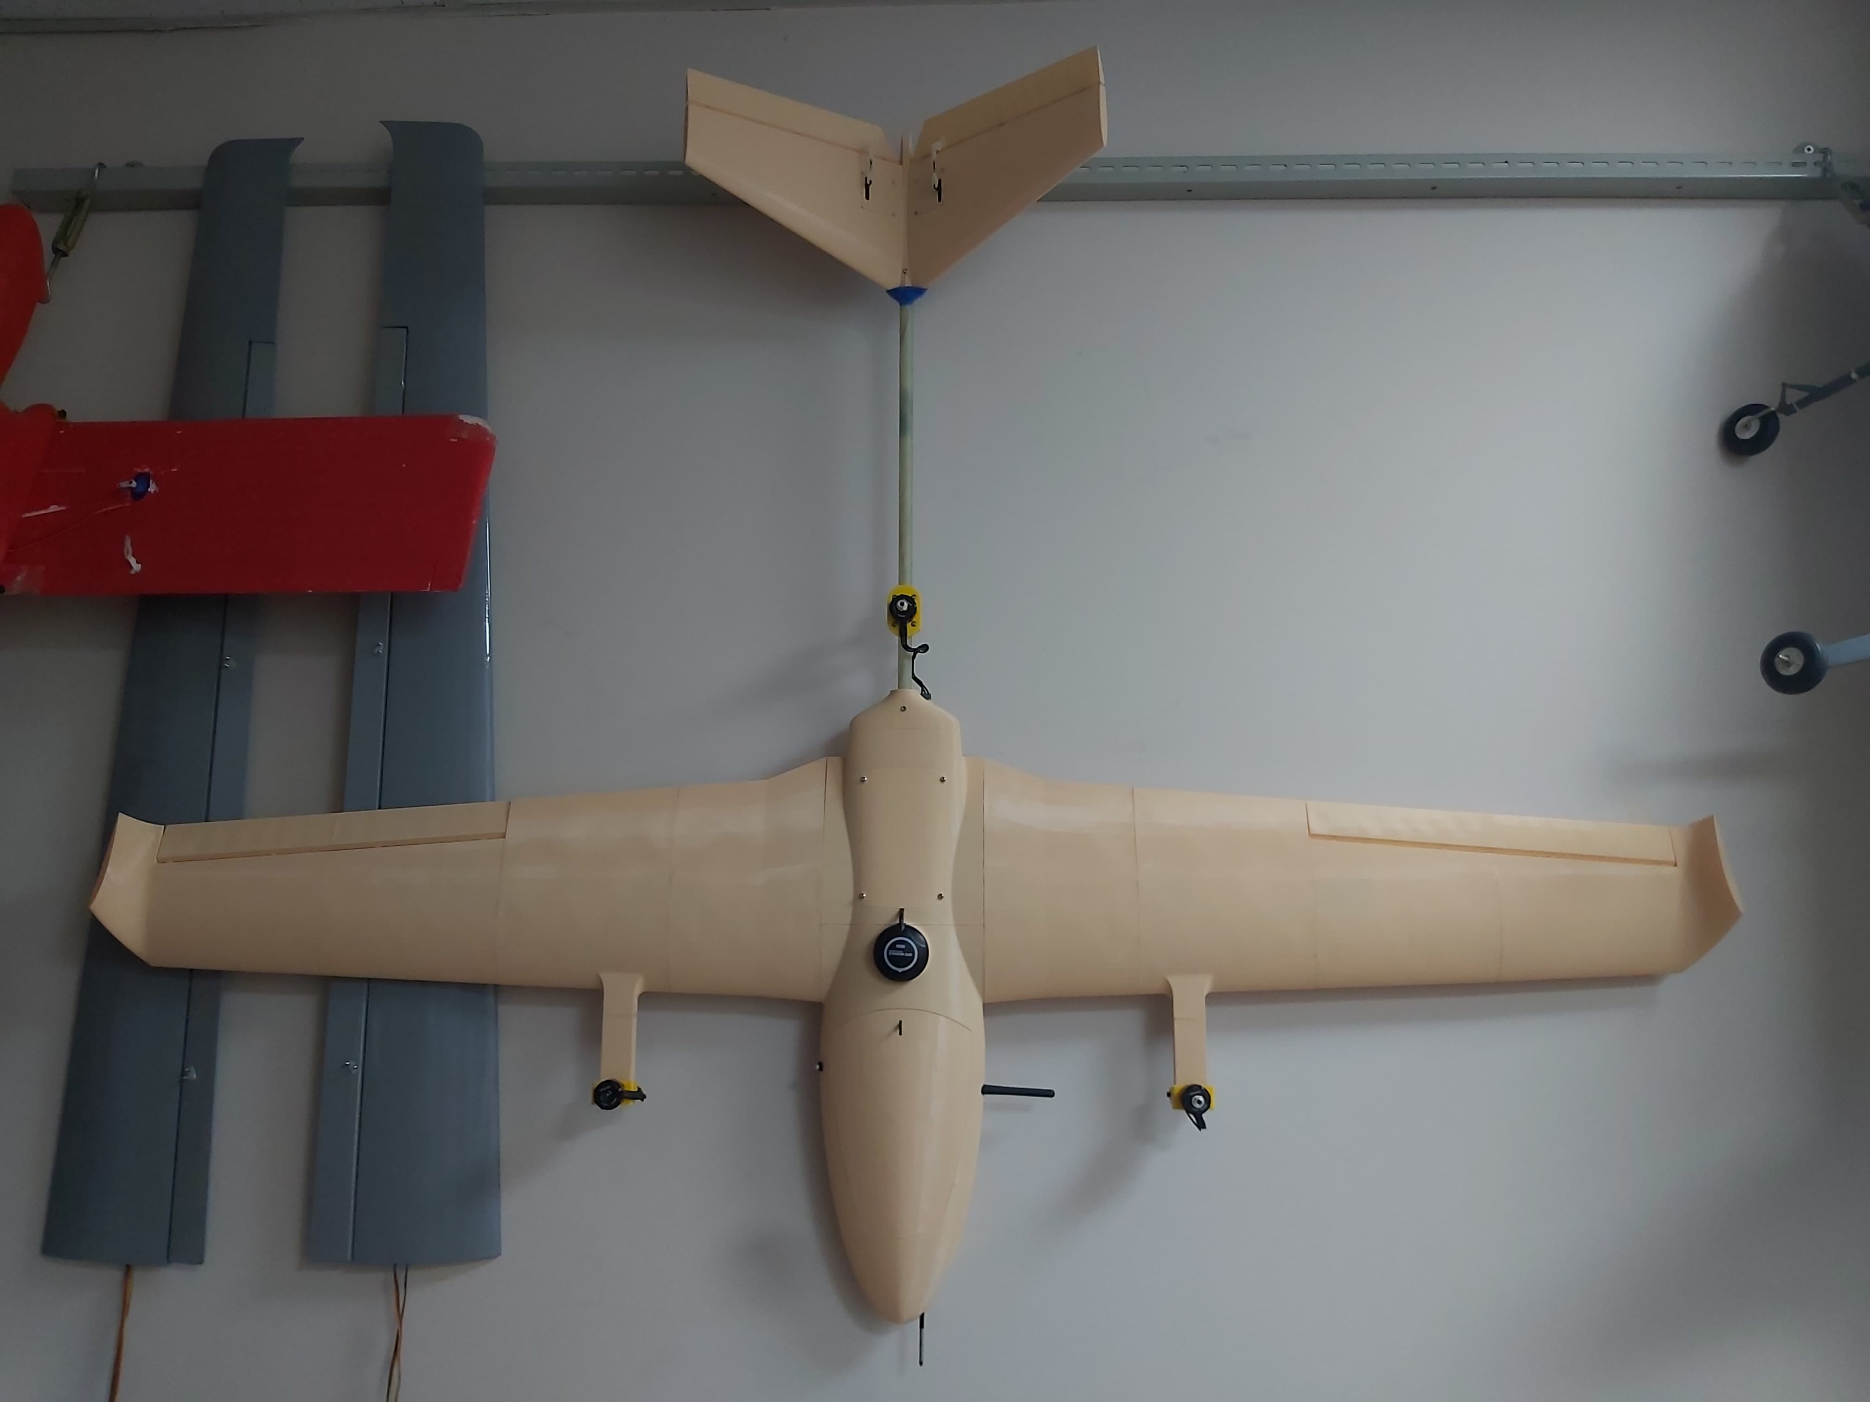
Assembly of VTOL

Slide 19
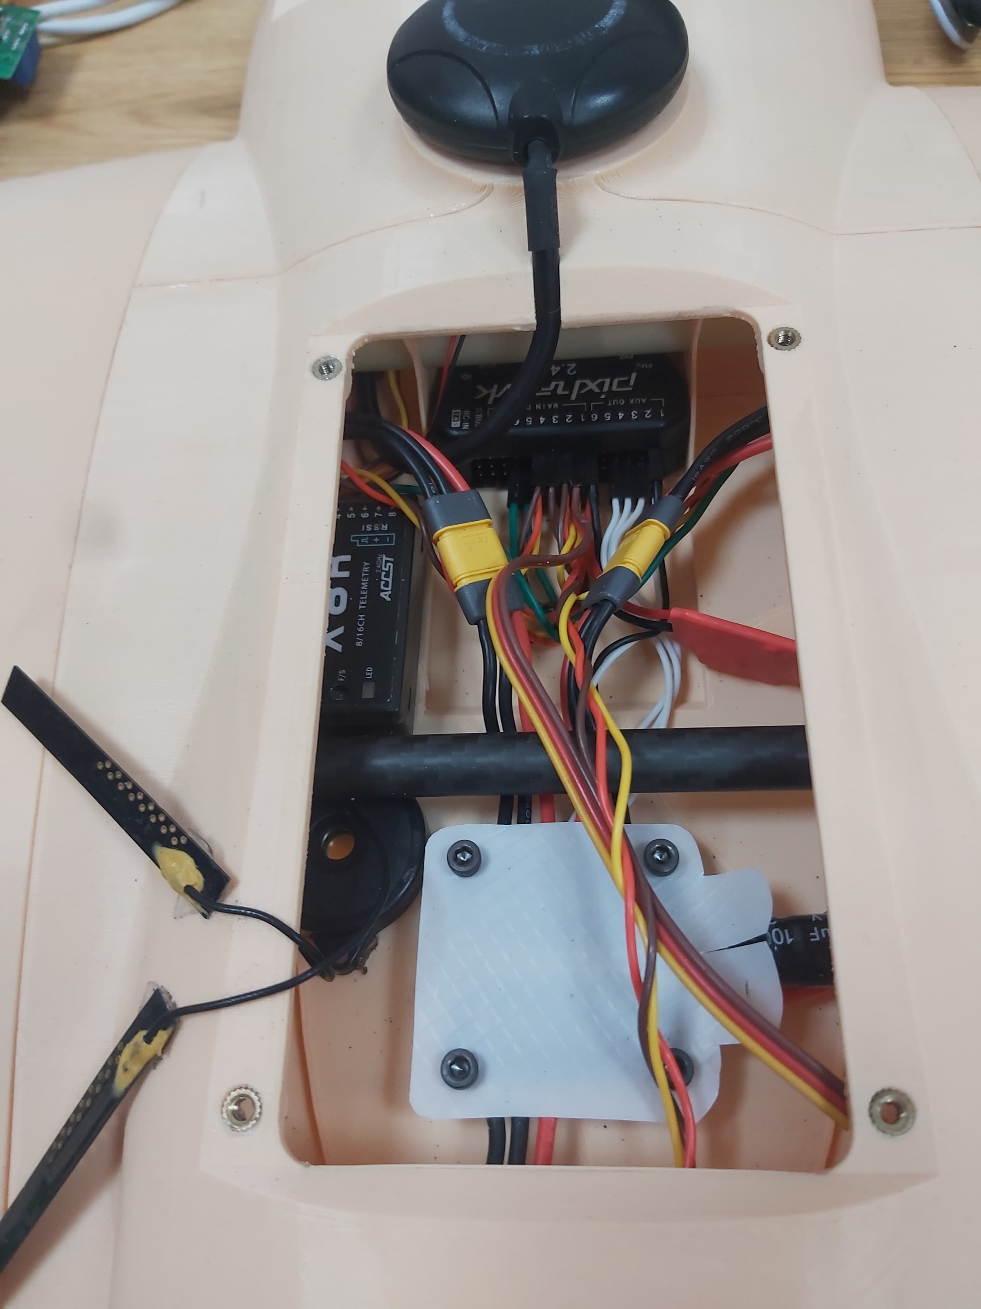
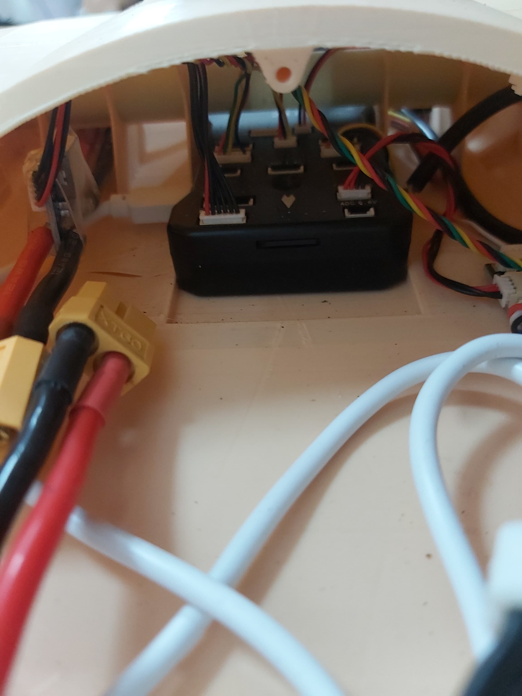
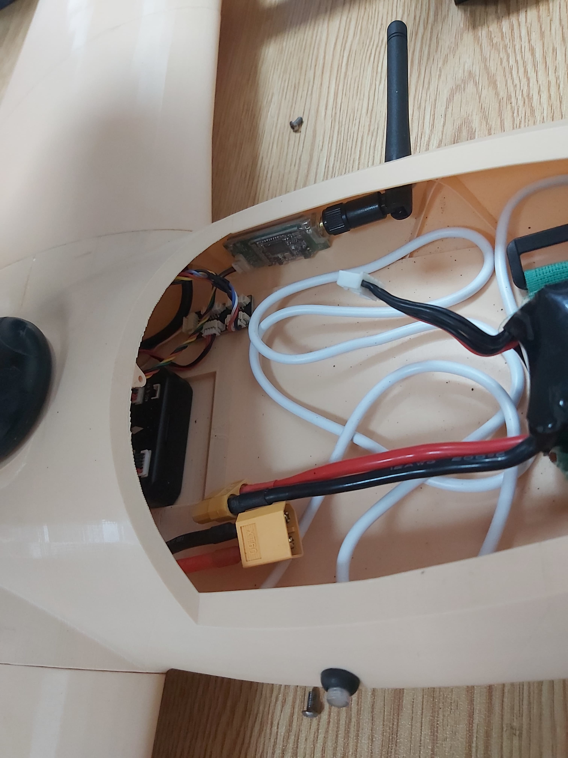
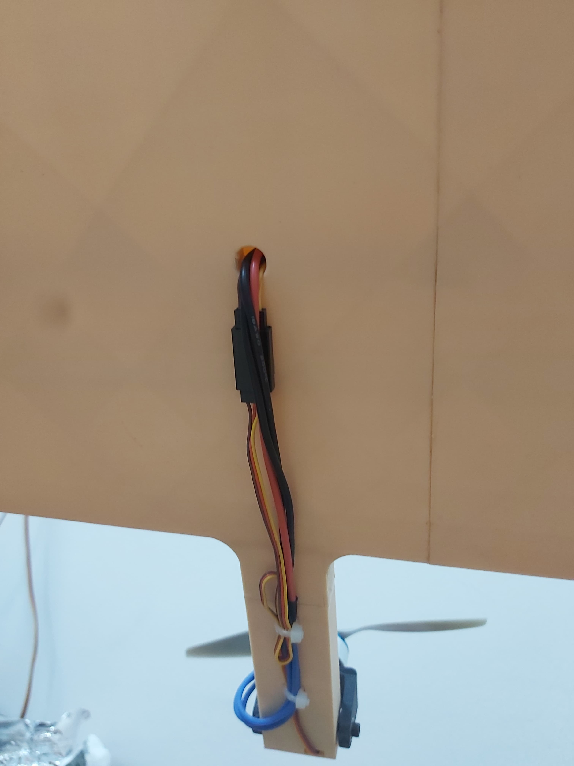
Electronic Wiring of the Aircraft
Zipp Ties

Slide 20
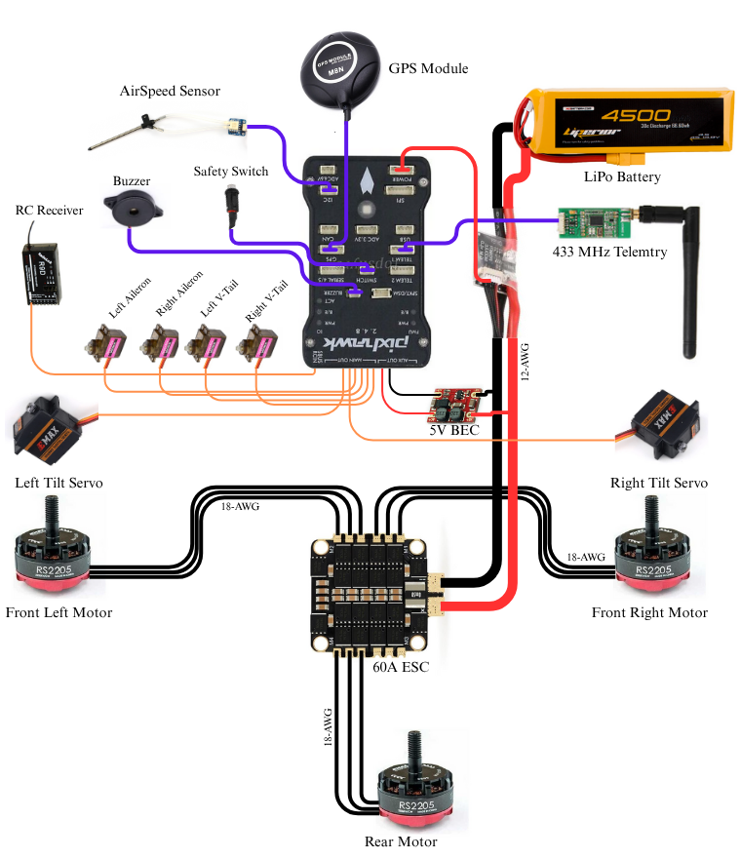
Detailed Wiring Diagram
-Sensors
-Population System
-Communication System
-Control Surface Servos

Slide 21
Autopilot Configuration
ArduPlane 4.6 open-source sofware is used as a autopilot.
Some parameters needed to change for VTOL configuration:
Title of the Parameter | Default Value | Modified Value | Definition
Q_ENABLE | 0 | 1 | Indicates that the vehicle is VTOL and enables the VTOL parameters to be activated.
Q_TILT_ENABLE | 0 | 1 | Indicates that the VTOL vehicle has tiltable rotors.
Q_FRAME_CLASS | 0 | 7 | It allows to select a frame type, 7 indicates Tricopter layout and frame type.
Q_TILT_MASK | 0 | 3 | A bitmask that specifies which rotors can tilt, 3 stands for the front two motors.
Q_TILT_TYPE | 0 | 2 | it allows to choose the tilt modality. 2 means that its vectored, and tilt mechanism can control the yaw in vertical fight.
Q_TILT_RATE_UP | 20 | 15 | Selects the speed at which the motors will tilt upwards (degree/sec)
Q_ASSIST_SPEED | 0 | -1 | For quad-in-plane vehicles, it specifies below which speed the vertical motors will assist lift. Deactivated.
Q_M_PWM_TYPE | 0 | 5 | Selects what type of signal the ESC will be fed with. 5 indicates DShot150 protocol.
Q_TRANSITION_MS | 5000 | 7000 | Determines how many milliseconds the transition process takes.
Q_M_BAT_VOLT_MAX | 12.6 | 16.8 | Indicates maximum battery voltage. 4S battery is 16.8 volts.
Q_M_BAT_VOLT_MIN | 11.1 | 14.0 | Indicates minimum battery voltage. Warning below set value.

Slide 22
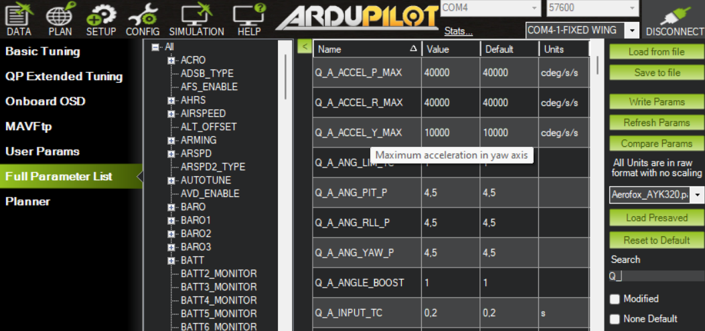
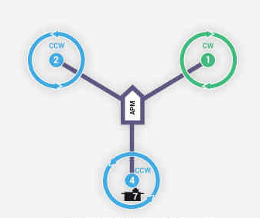
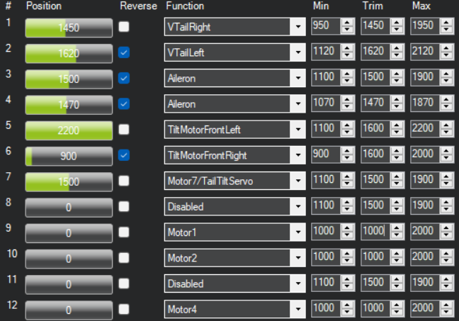
ArduPlane Tricopter Diagram
Mission Planner ground station software is used.
İt can be connected to controller with Telemetry or USB Cable.
Shown parameters in previous slide can be changed at this window.
From SETUP -> Servo Outputs: Each actuator and their limits must be arranged.
Motor Numbers and directions of rotation are important in servo output screen.

Slide 23
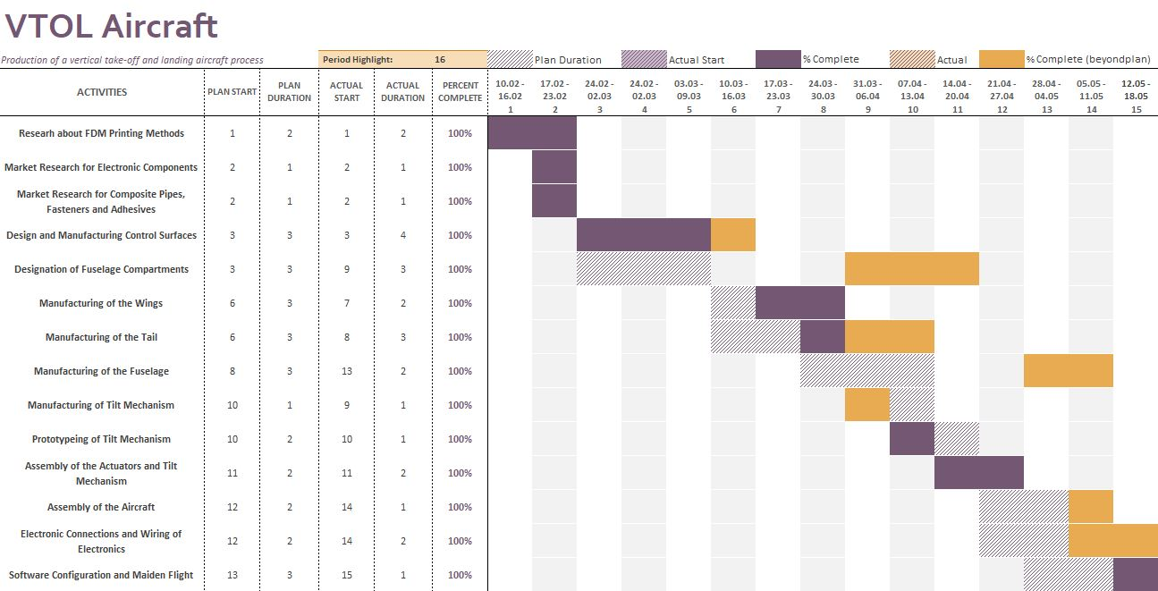
Gannt Chart

Slide 24
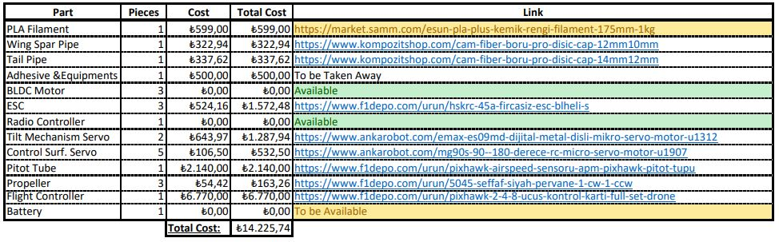
Cost Analysis
The cost was calculated ~22000₺ at the first Semester.
It is managed to reduce cost by 30% after detailed market research.

Slide 25
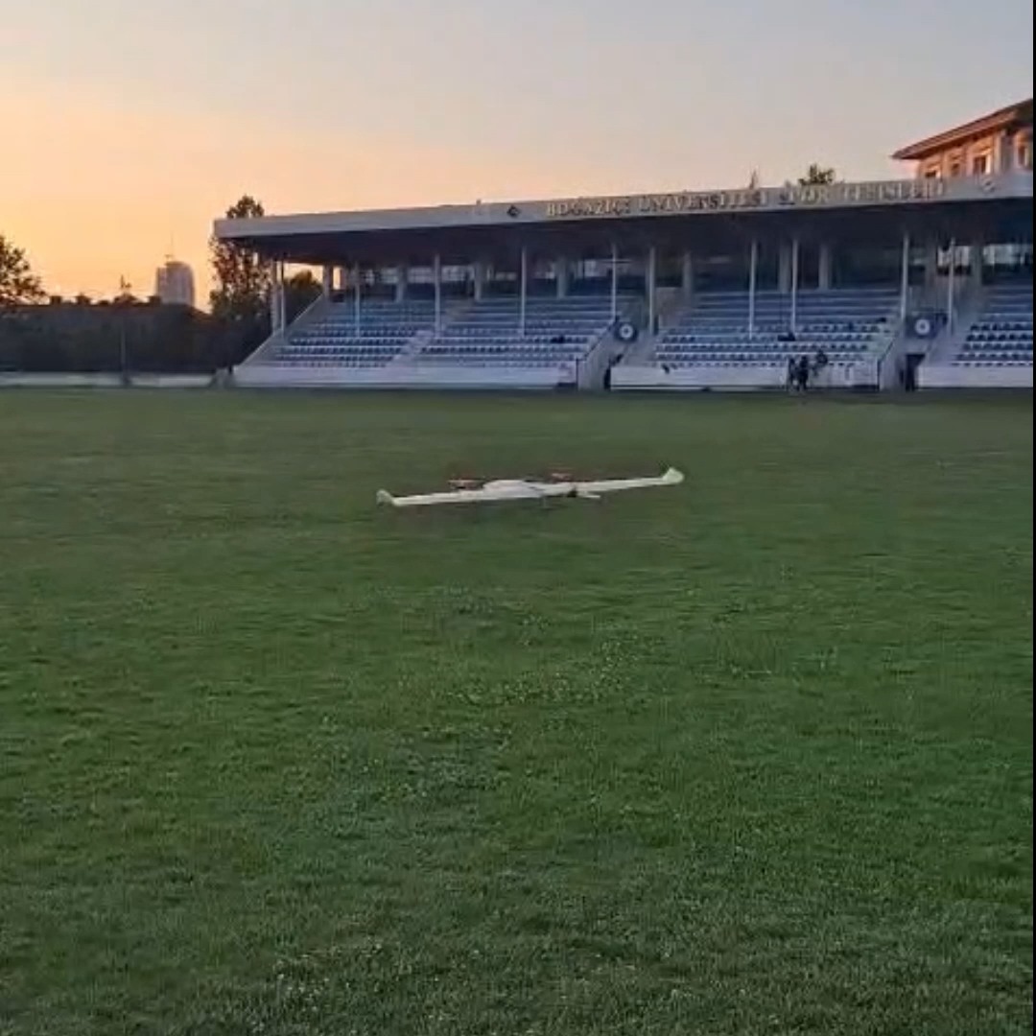
Hover Test Flight

